Slide 1
Basic Text Analysis
Jeremy Guillette
History Department Digital Scholarship Facilitator

Slide 2
bit.ly/DFvoyant

Slide 3
How do computers understand text?
See
Spot
run
See Spot run.
S
e
e
S
p
o
t
r
u
n
.
01010011
01100101
01100101
00100000
01010011
01110000
01101111
01110100
00100000
01110010
01110101
01101110
00101110
Notes:
Let's take a very simple example, one where we can see how a computer understands text.
[animate in sentence]
We're interested in the words that are being used in a text, so we need the computer to understand what words are.
[animate in word braces]
However, the computer really only understands letters.
[animate in letter braces]
At an even lower level, the computer understands characters as a set of eight bits (ones and zeros) each. Spaces, punctuation, and other non-letter things are also characters, and the computer can only treat them differently from letter characters if we tell it to. We can do this, but sometimes these low-level concerns come up. For instance, if you're analyzing sentence structure, you might want to use punctuation to end a sentence. What happens in abbreviations and professional titles then? It's difficult to get a computer to understand context, even in the very simple case of determining whether a period is being used to end a sentence or to abbreviate a word. Fortunately, we've been using computers to analyze text for long enough that there are good routines for processing language, at least for English. Voyant, the tool we'll be using, automatically separates letters into words for us, so you don't need to worry too much about it for now.

Slide 4
How do computers understand text?
identical = identical
Spot ≠ spot
Run ≠ Ran
sincerely ≠ fincerely
Notes:
Only identical words match. You'll often find that systems are case sensitive, so that a capitalized word is not the same as an uncapitalized word.
Different forms of the same word are also not recognized as the same word, and this requires a more sophisticated approach to solve, and even then only imperfectly
Sometimes you get OCR errors or typos that throw off your analysis as well, just watch for them.

Slide 5
That seems like a lot of work...
That's why we use tools! Let's go to Voyant Tools and see what this work can get us.

Slide 6
voyant-tools.org
🌎
🏠
github.com/sgsinclair/VoyantServer
Notes:
You can use a ready made installation of Voyant online, or you can download and install it locally. Either way you access the tool through your browser, but the local version is only running on your computer, as opposed to on someone else's

Slide 7
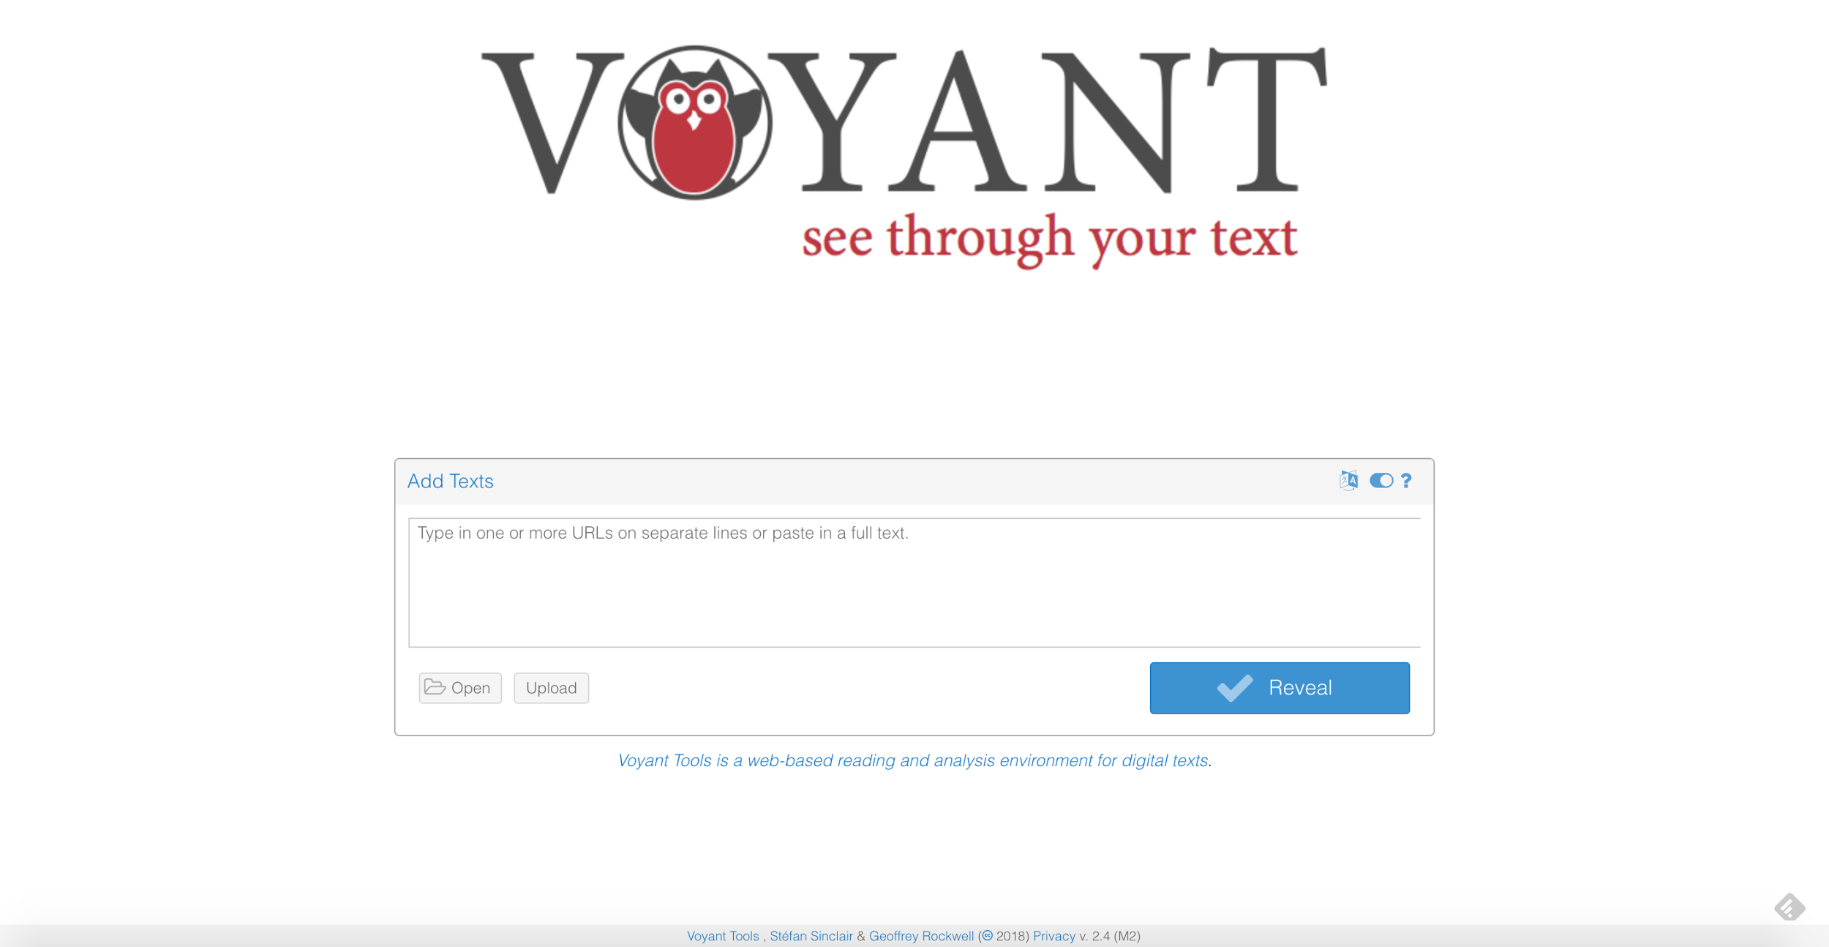
Notes:
This is what you see when you get to Voyant, either on the web or locally. This is where you upload your corpus.

Slide 8
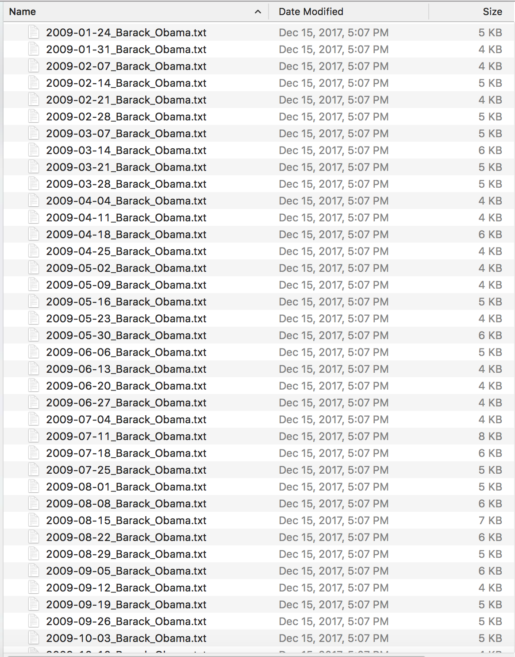
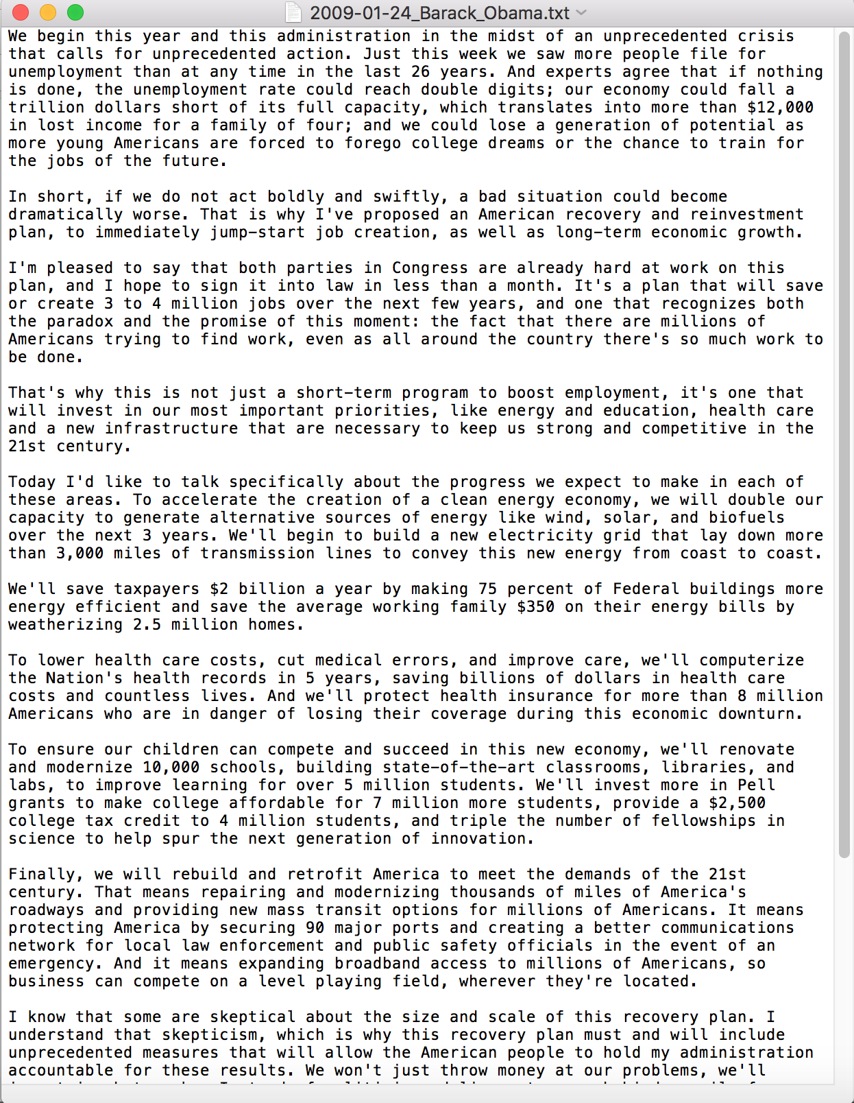
Notes:
This is our corpus. Metadata in filenames, plain text of speeches. Acquired via scrape

Slide 9
presidency.ucsb.edu/satradio.php
Notes:
This is where I scraped data from. Good place to try out some scraping, but be nice. Generous timers and such.

Slide 10
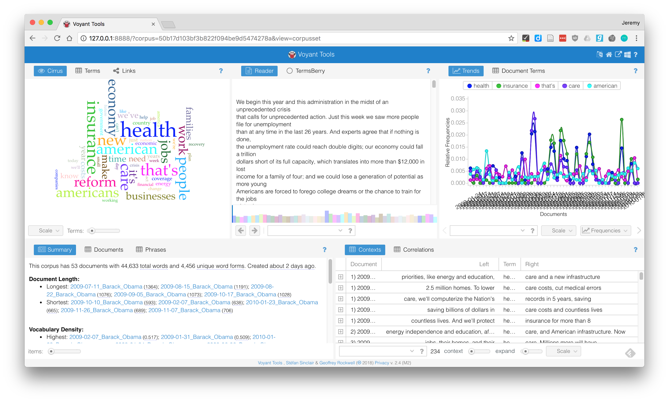
Notes:
This is what you see when you first load a corpus

Slide 11
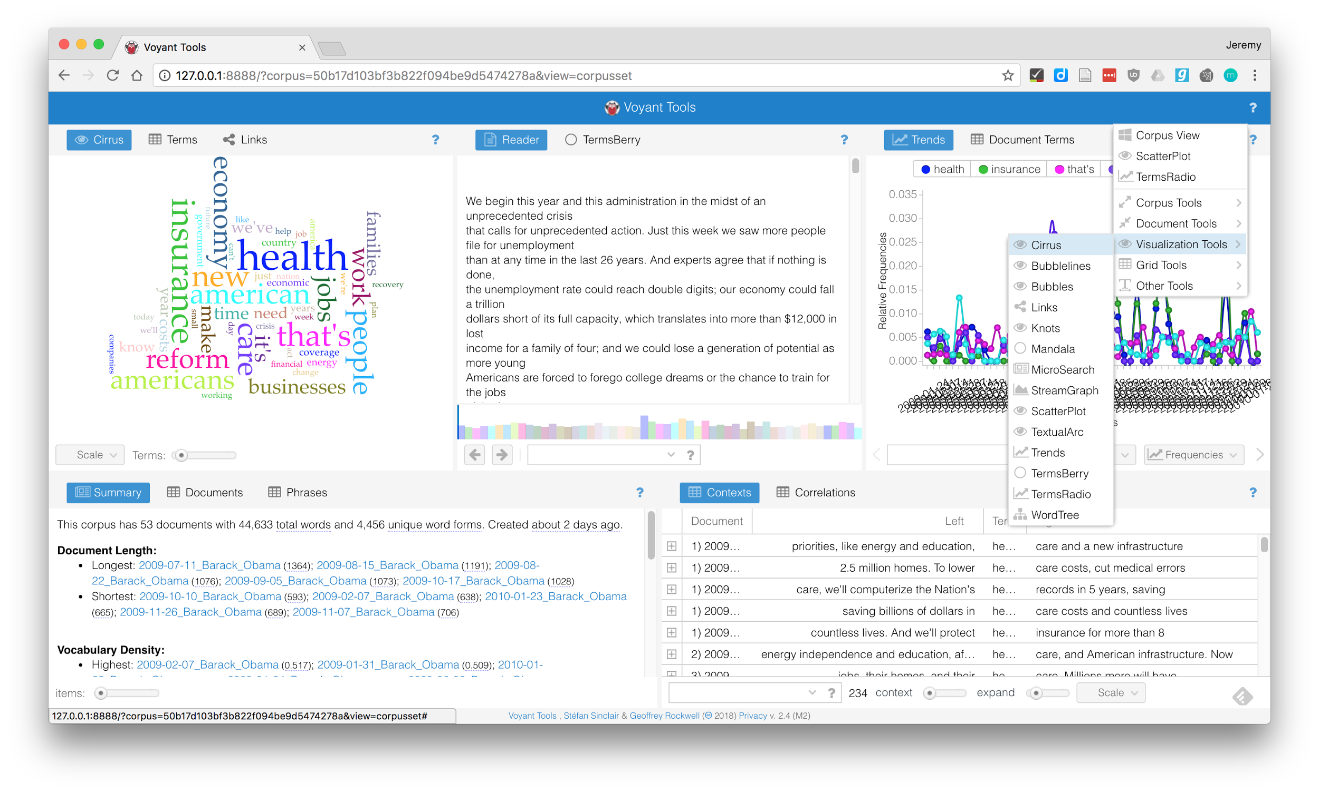
Notes:
This is how you change the full screen view, to get a better look at a single tool (word cloud, see title)

Slide 12
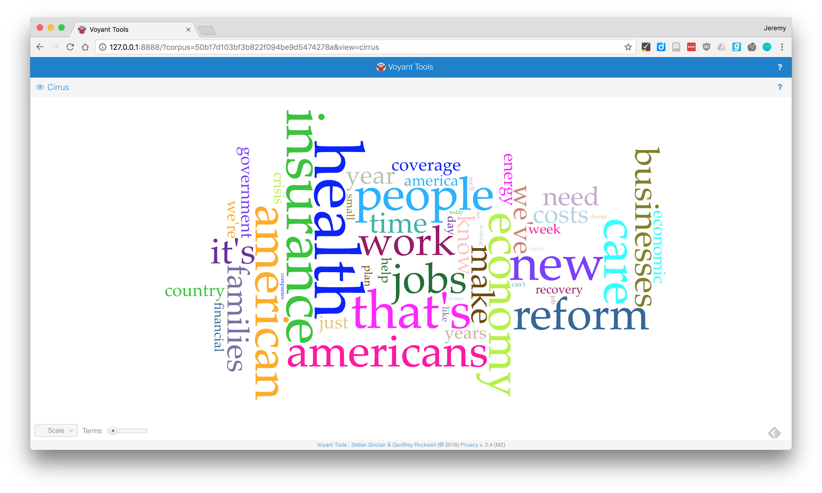
Notes:
Word cloud sizes words by raw frequency, highlighting general trends. What do you see?

Slide 13
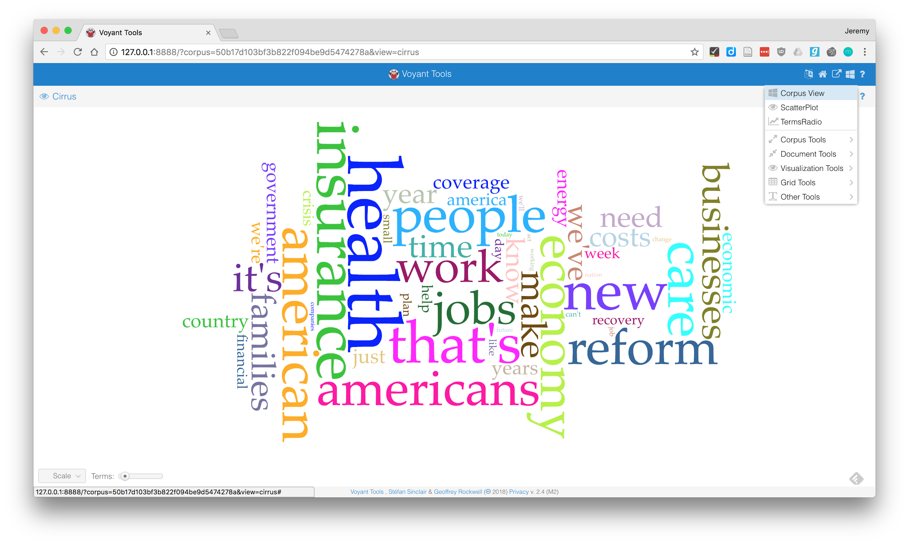

Slide 14
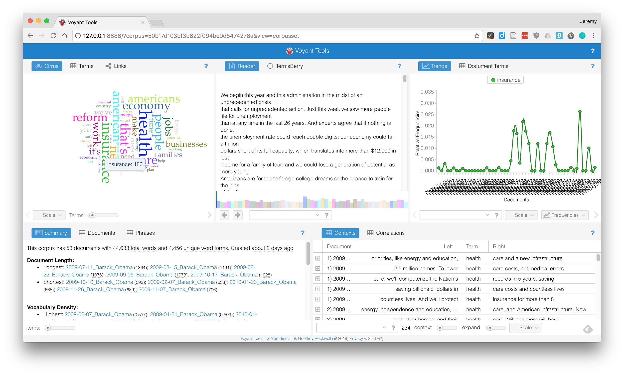
Notes:
Insurance a big topic in 2009, see count, filter trends view

Slide 15
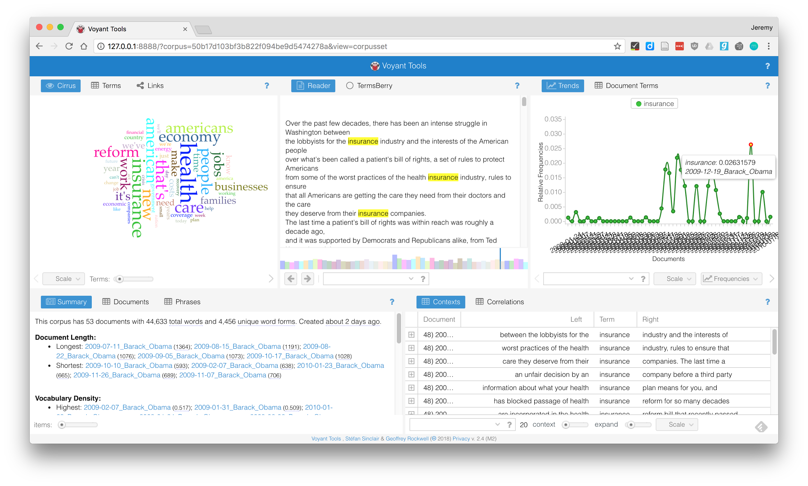
Notes:
Clicking on document in trends view updates reader and contexts, so you can see how term is used in context

Slide 16
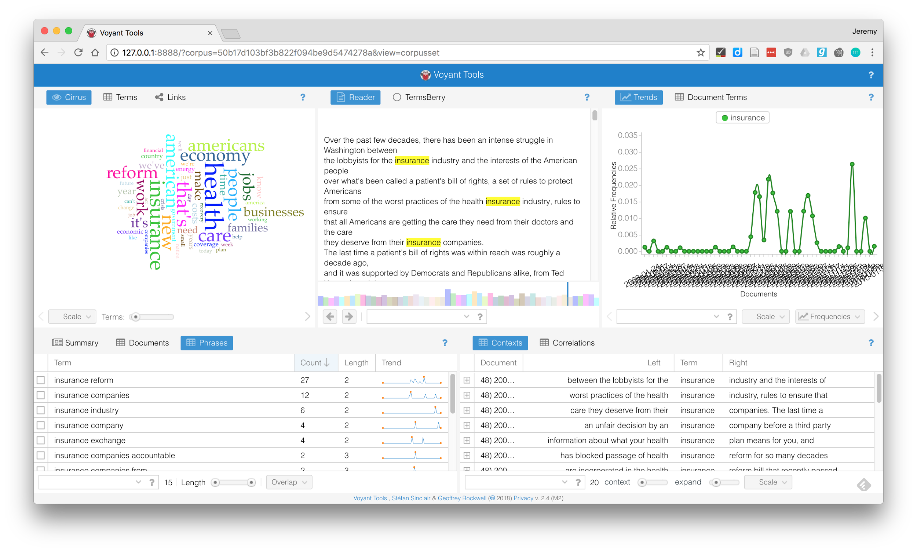
Notes:
Change bottom left window to "phrases" to see common combinations of words. I've sorted by count of phrase, to see most common
Could take this info and compare to pushes for ACA in congress, see how Obama used bully pulpit

Slide 17
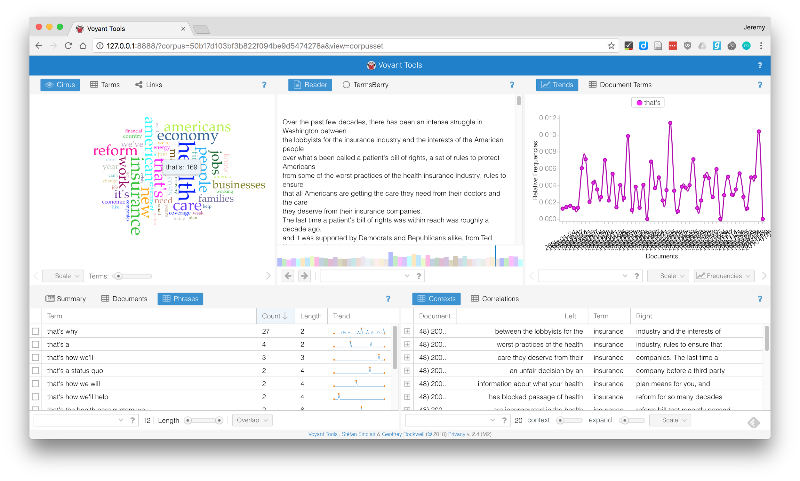
Notes:
Phrases, trends updates when we change term, but reader, contexts doesn't.

Slide 18
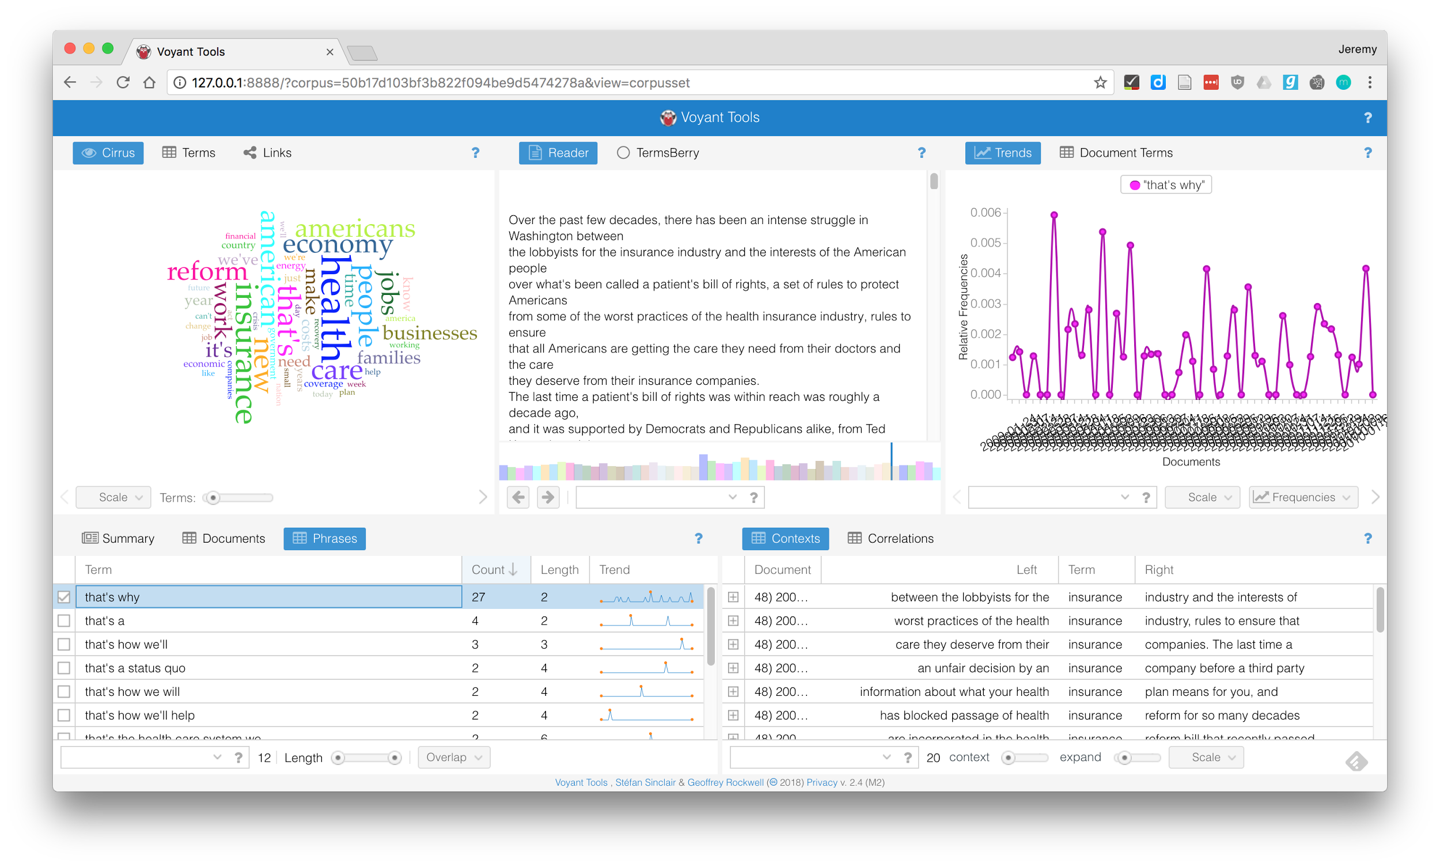
Notes:
Can also look at distribution of particular phrases, like this "that's why" that is so common

Slide 19
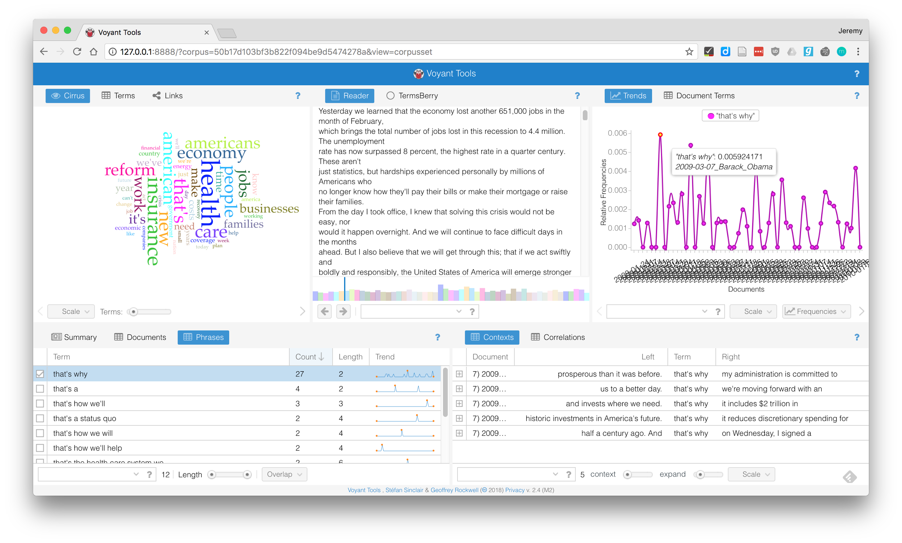
Notes:
Now we can see how it's used in context. Phrases don't get highlighted in reader, but can still find them. "That's why" is a rhetorical strategy Obama used in speeches: fact :: that's why :: actions

Slide 20
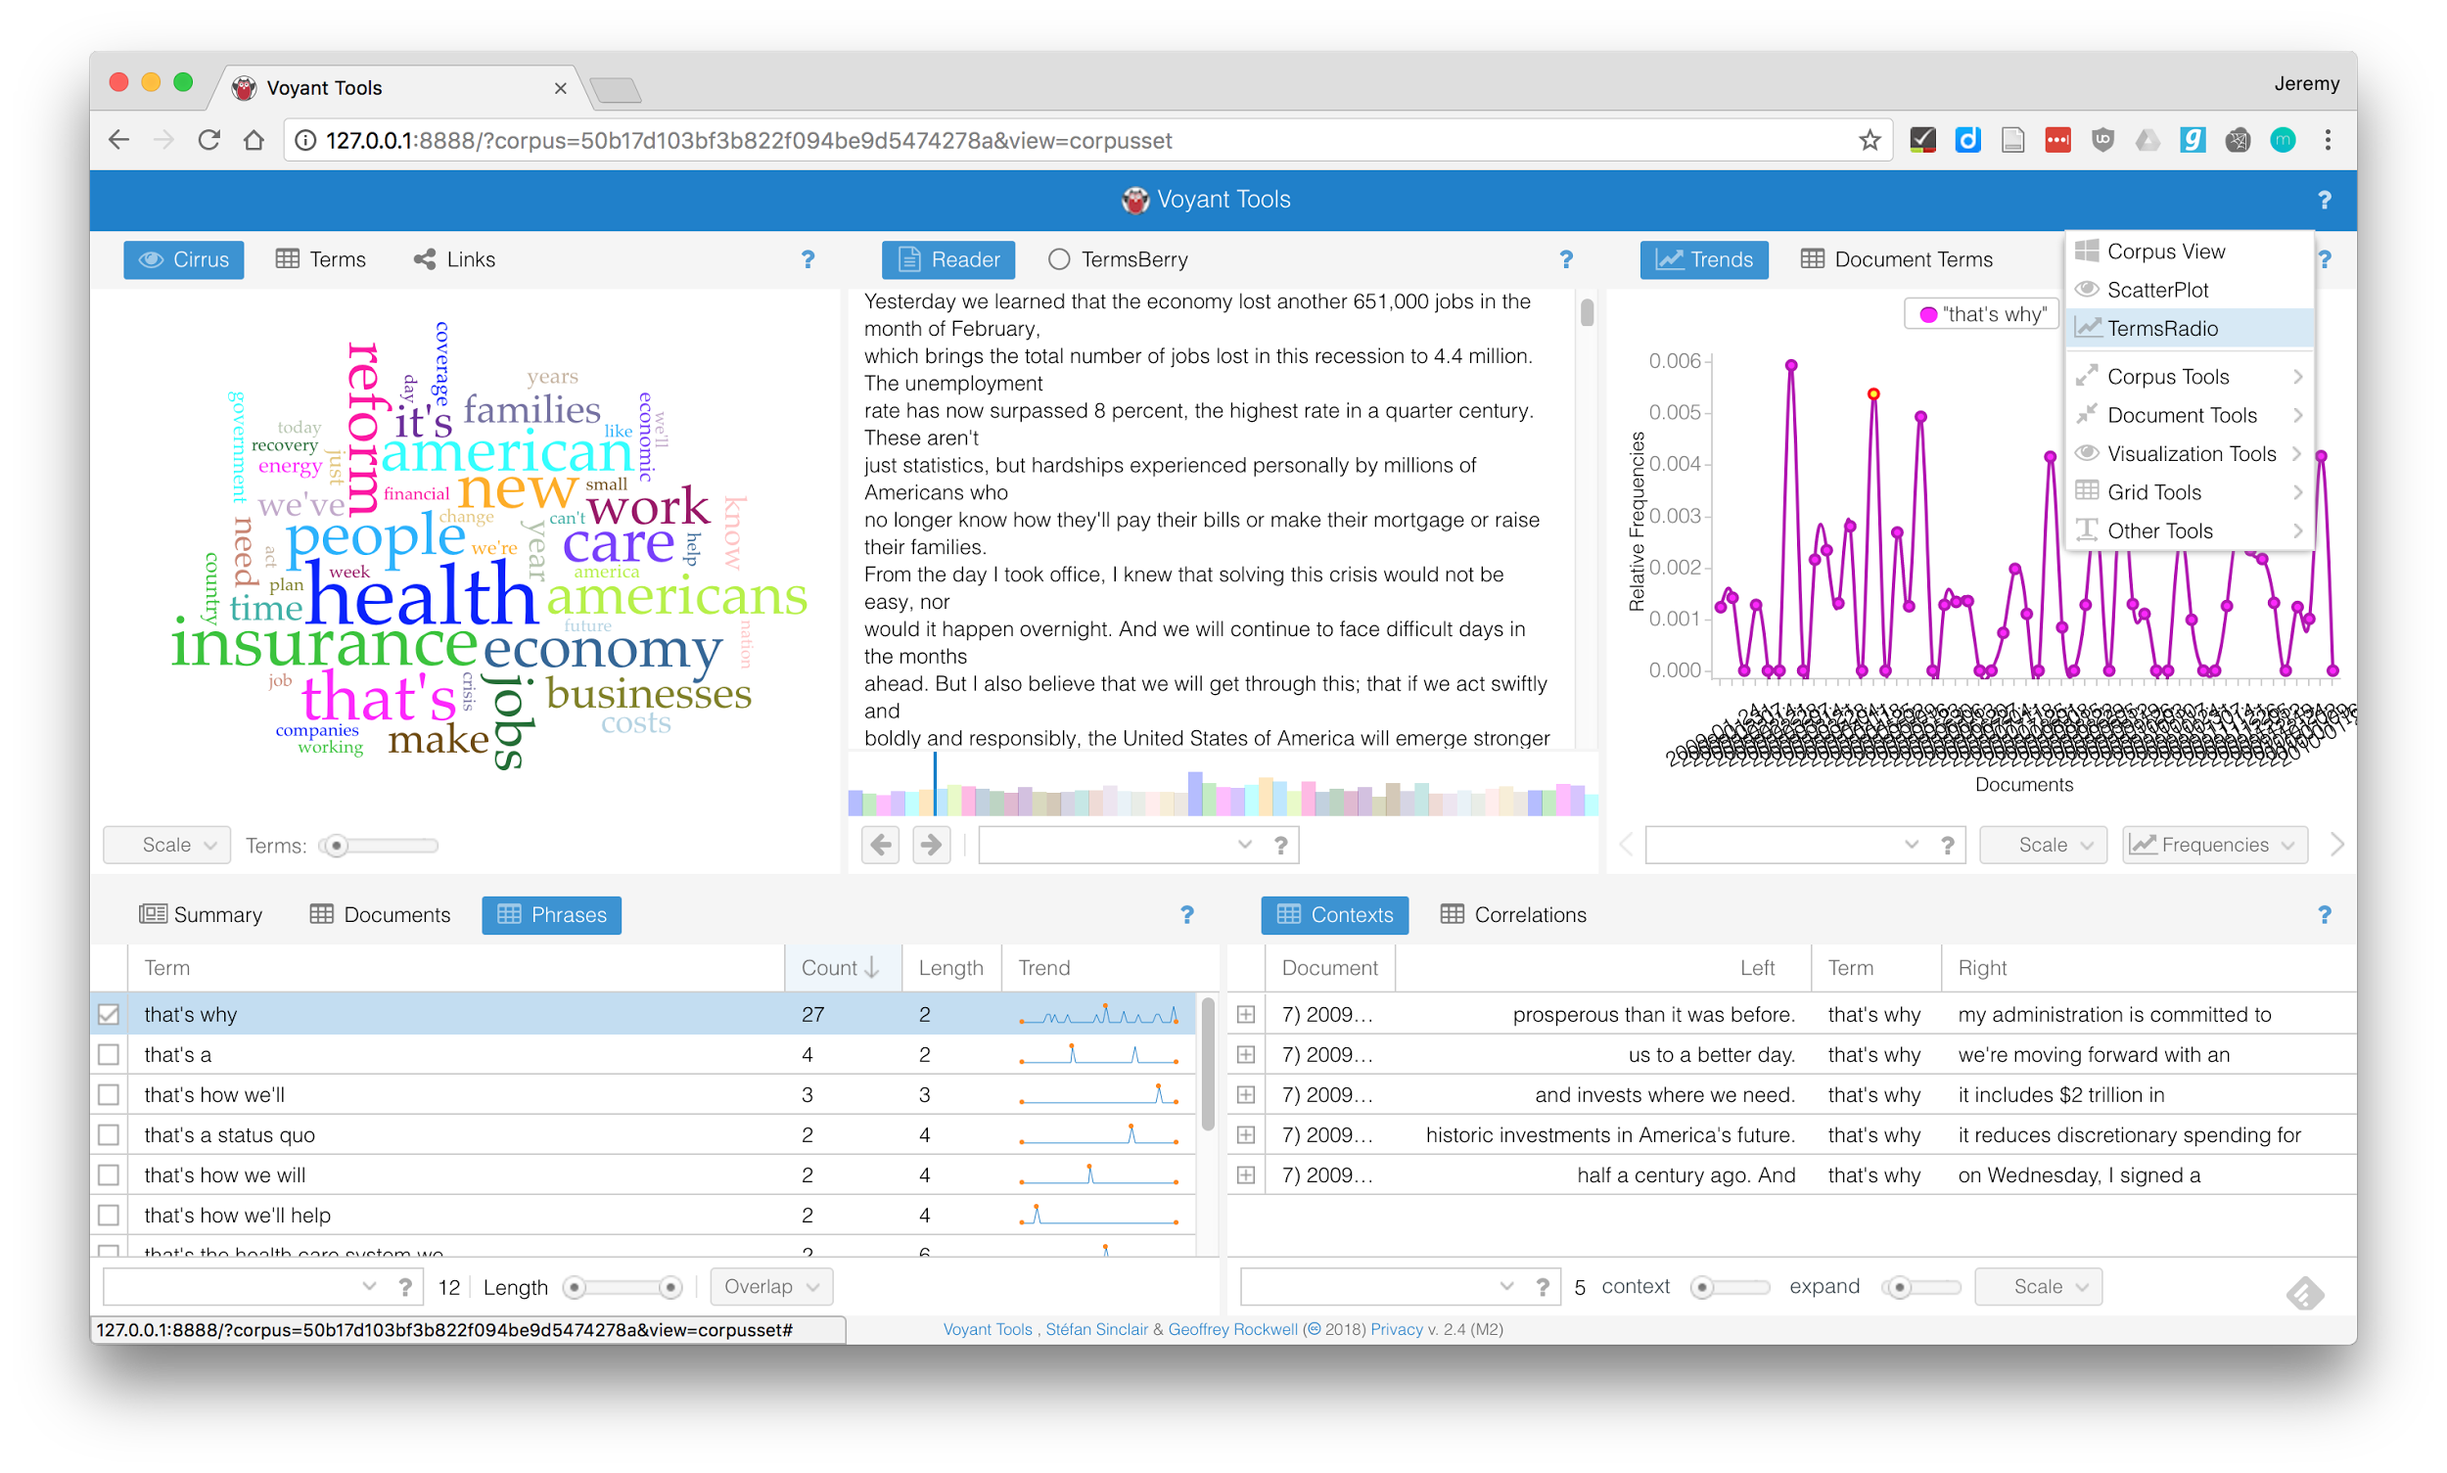

Slide 21
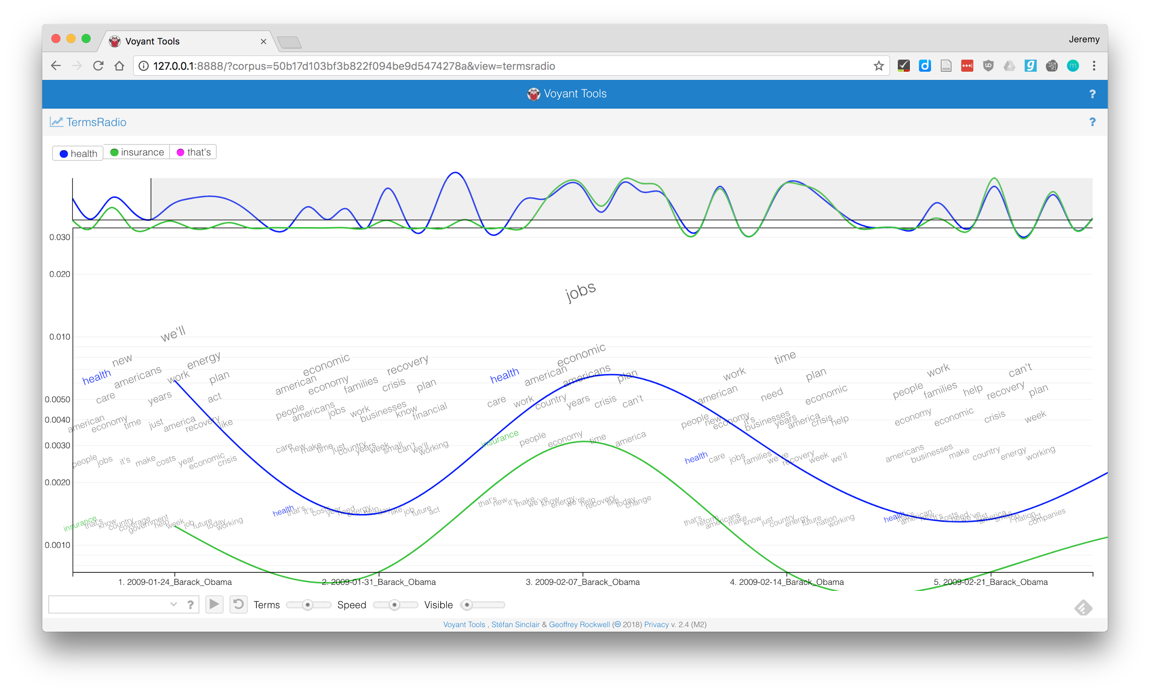
Notes:
Point out different parts of interface:
Active words (missing that's)
Overall timeline
Terms for single document
Search box and options

Slide 22
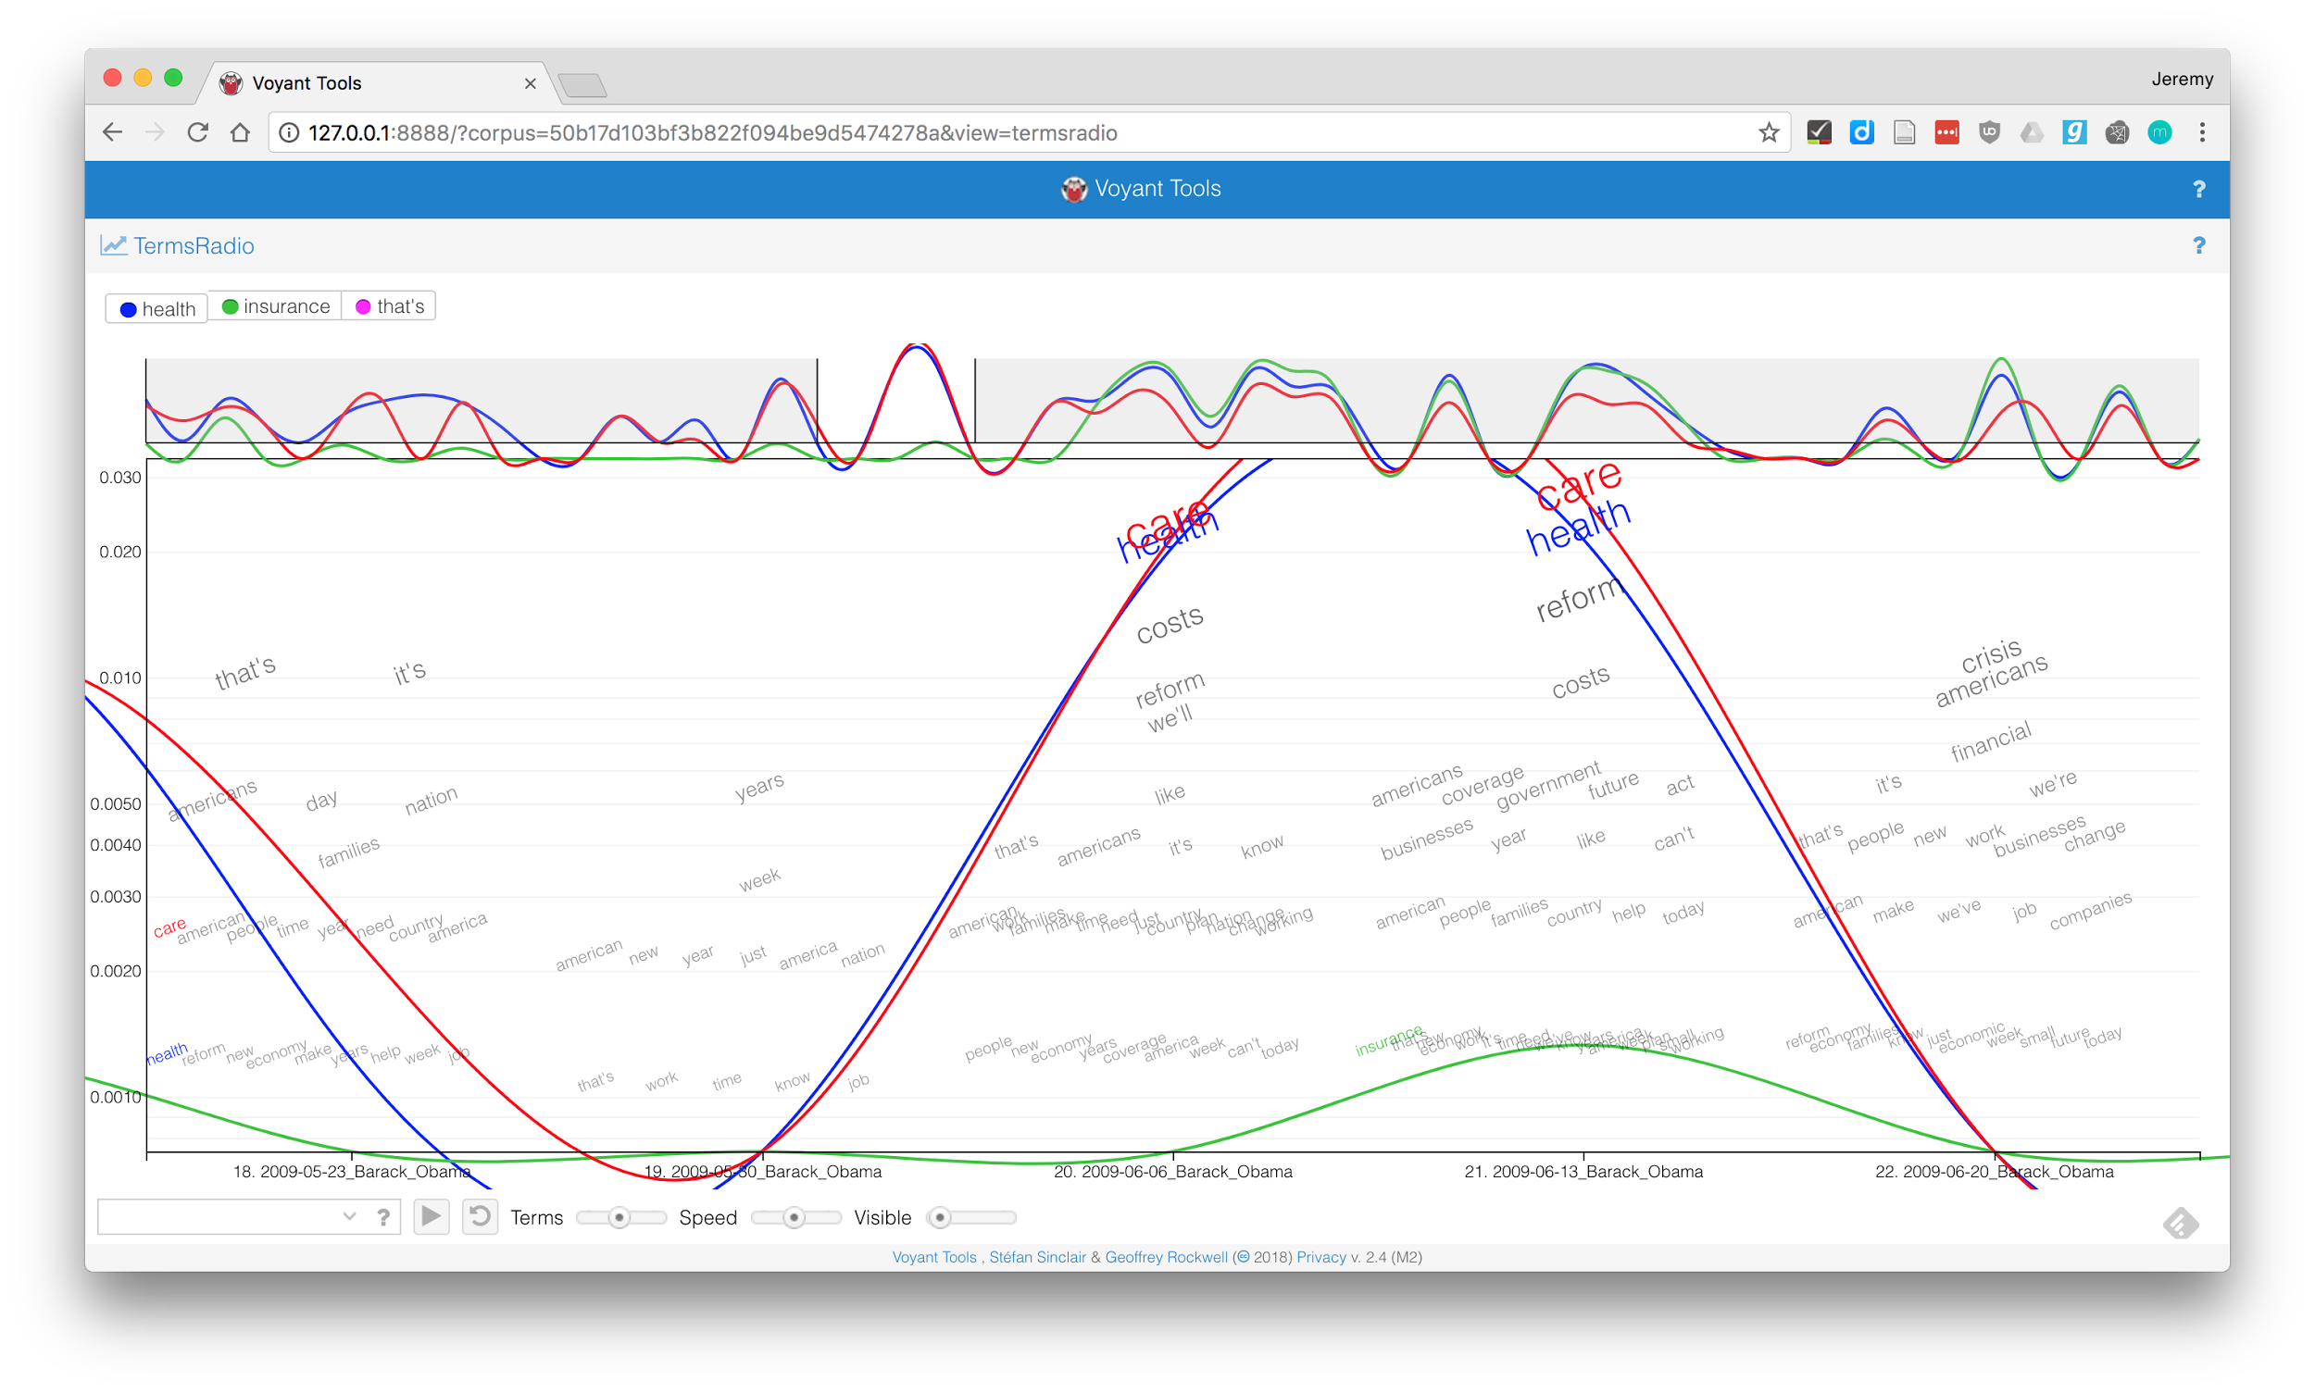
Notes:
Highlight a term to see trends in its use throughout text

Slide 23
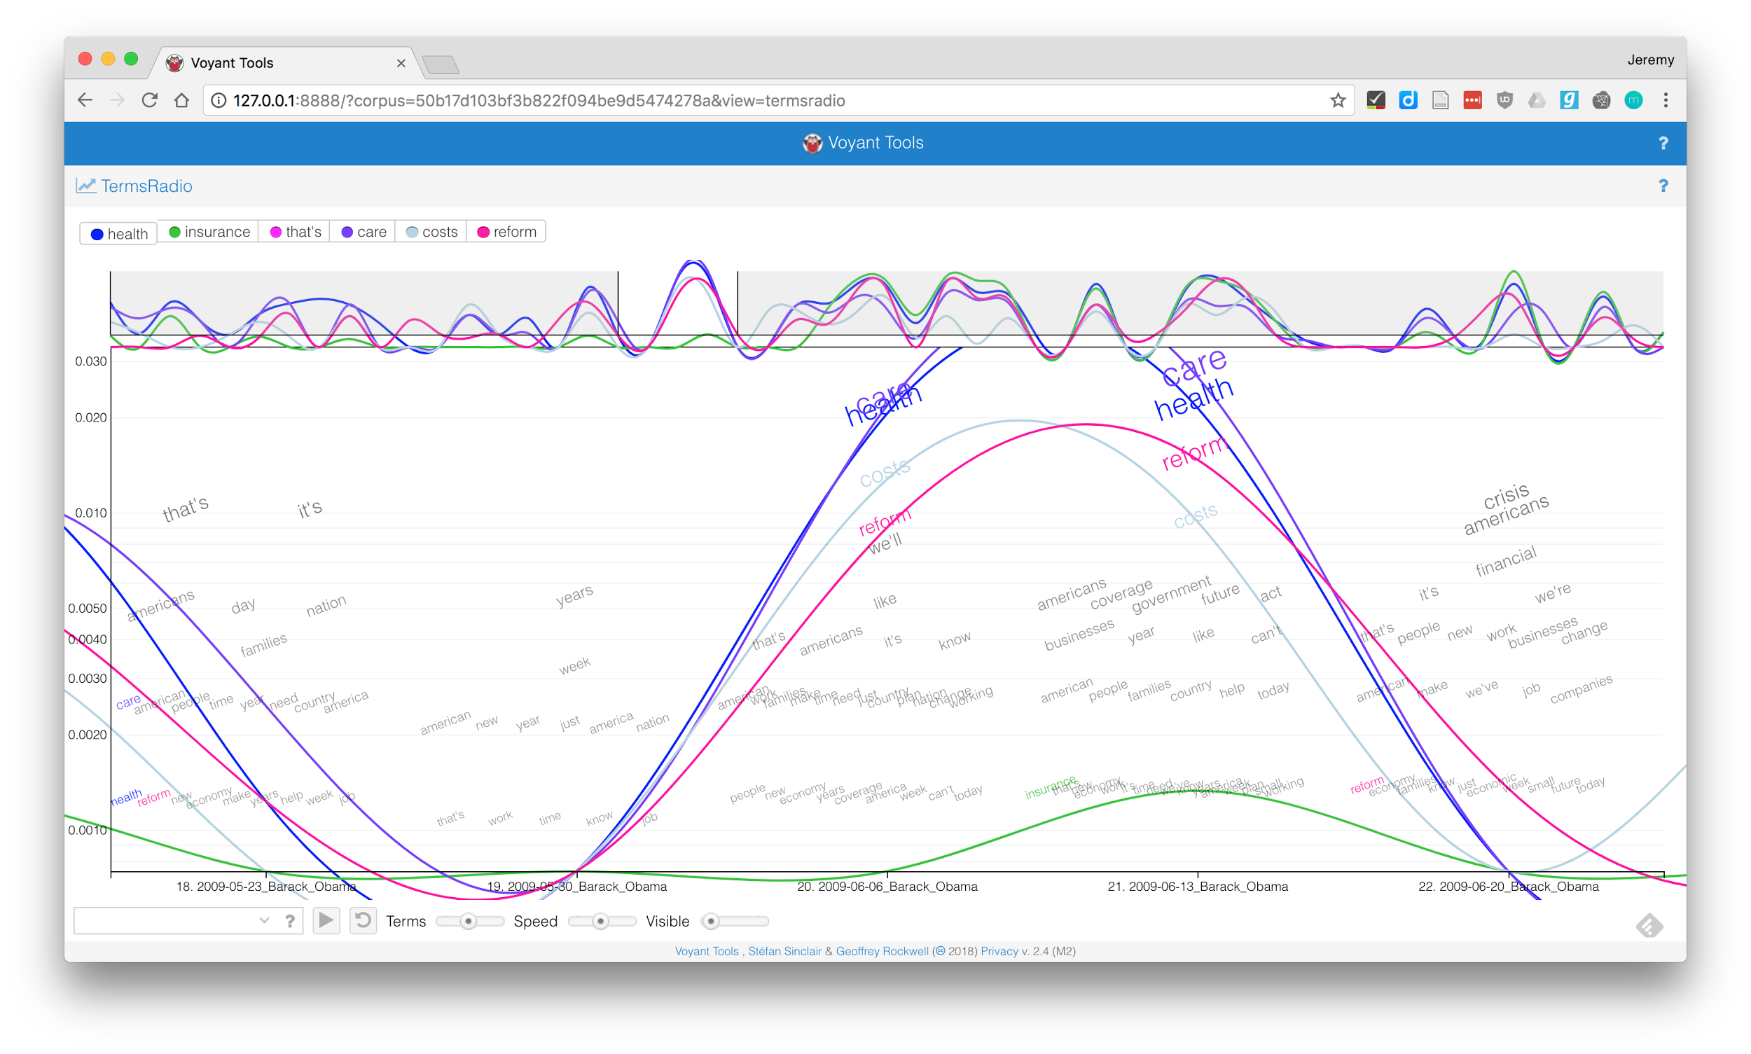
Notes:
Highlight more words, see where they diverge

Slide 24
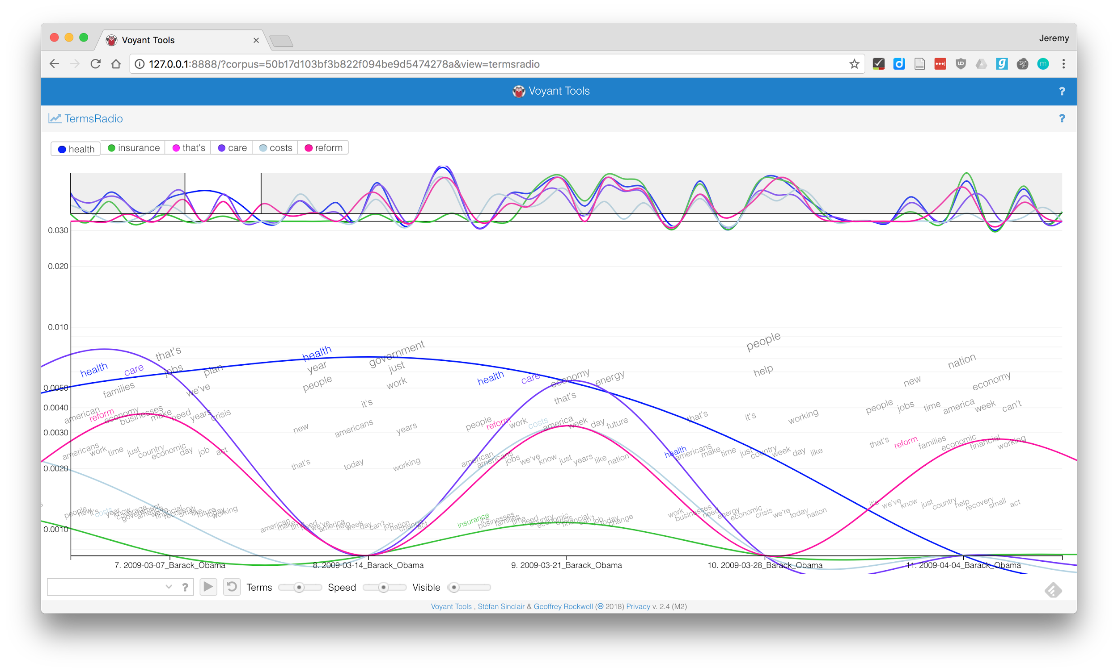
Notes:
This is odd, talking about health, but not insurance, care, or reform

Slide 25
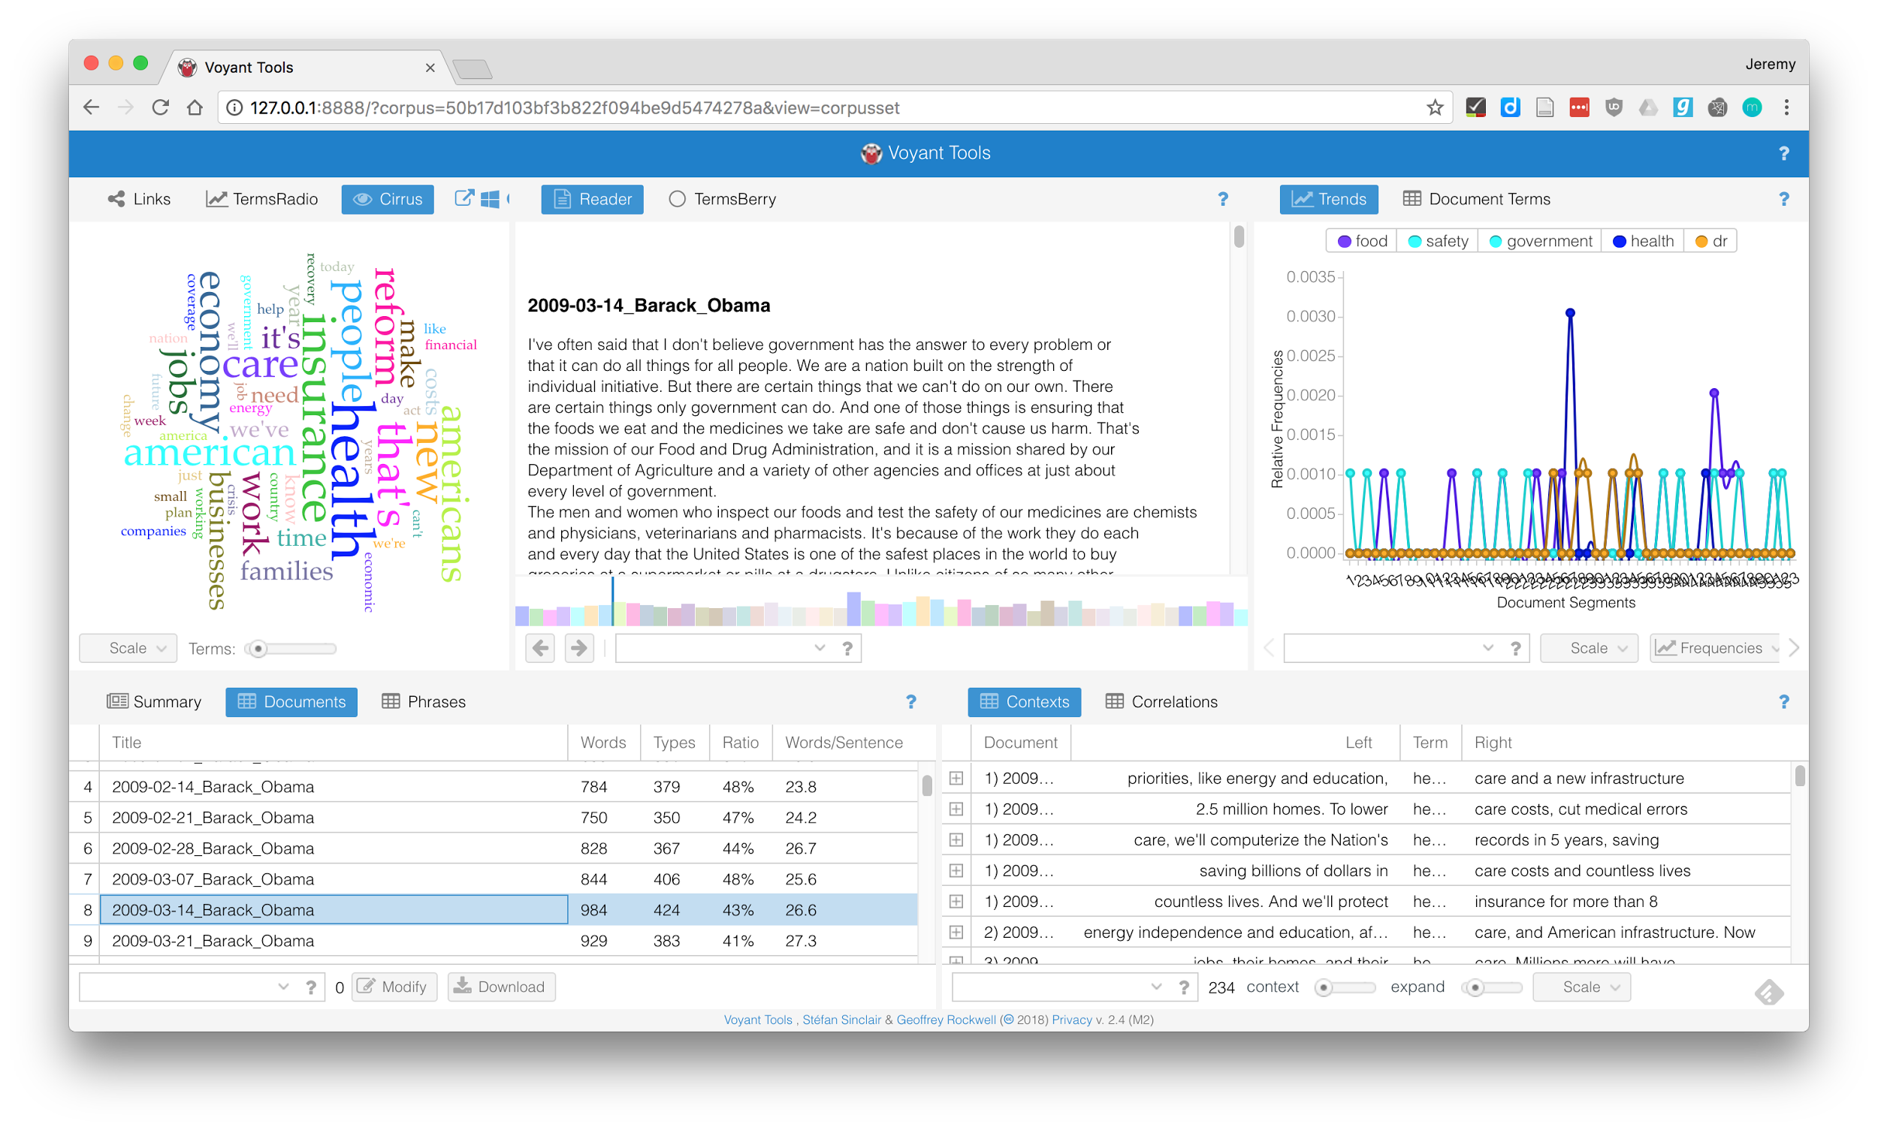
Notes:
Bit funkier to get back here to look at actual text. Need corpus view to select document, need to remember document name
But we can see that this is announcement of pick for FDA admins

Slide 26
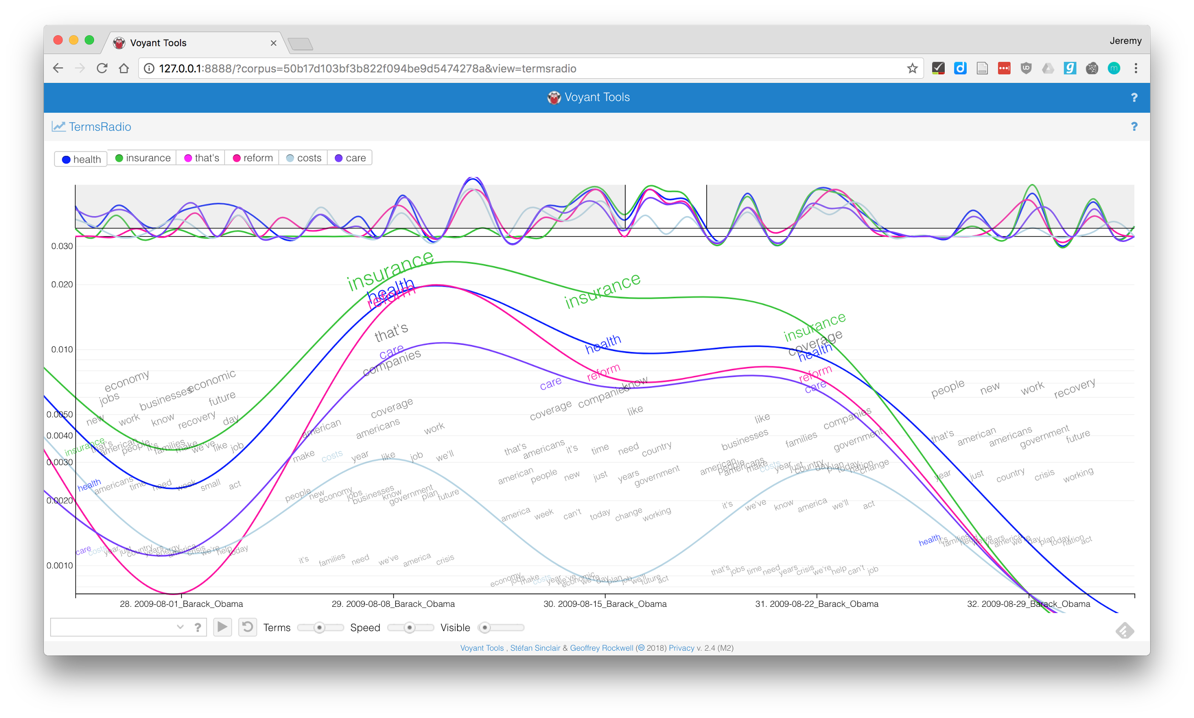
Notes:
Can also look at different trends in how terms are used, for instance talking about costs less than other terms

Slide 27
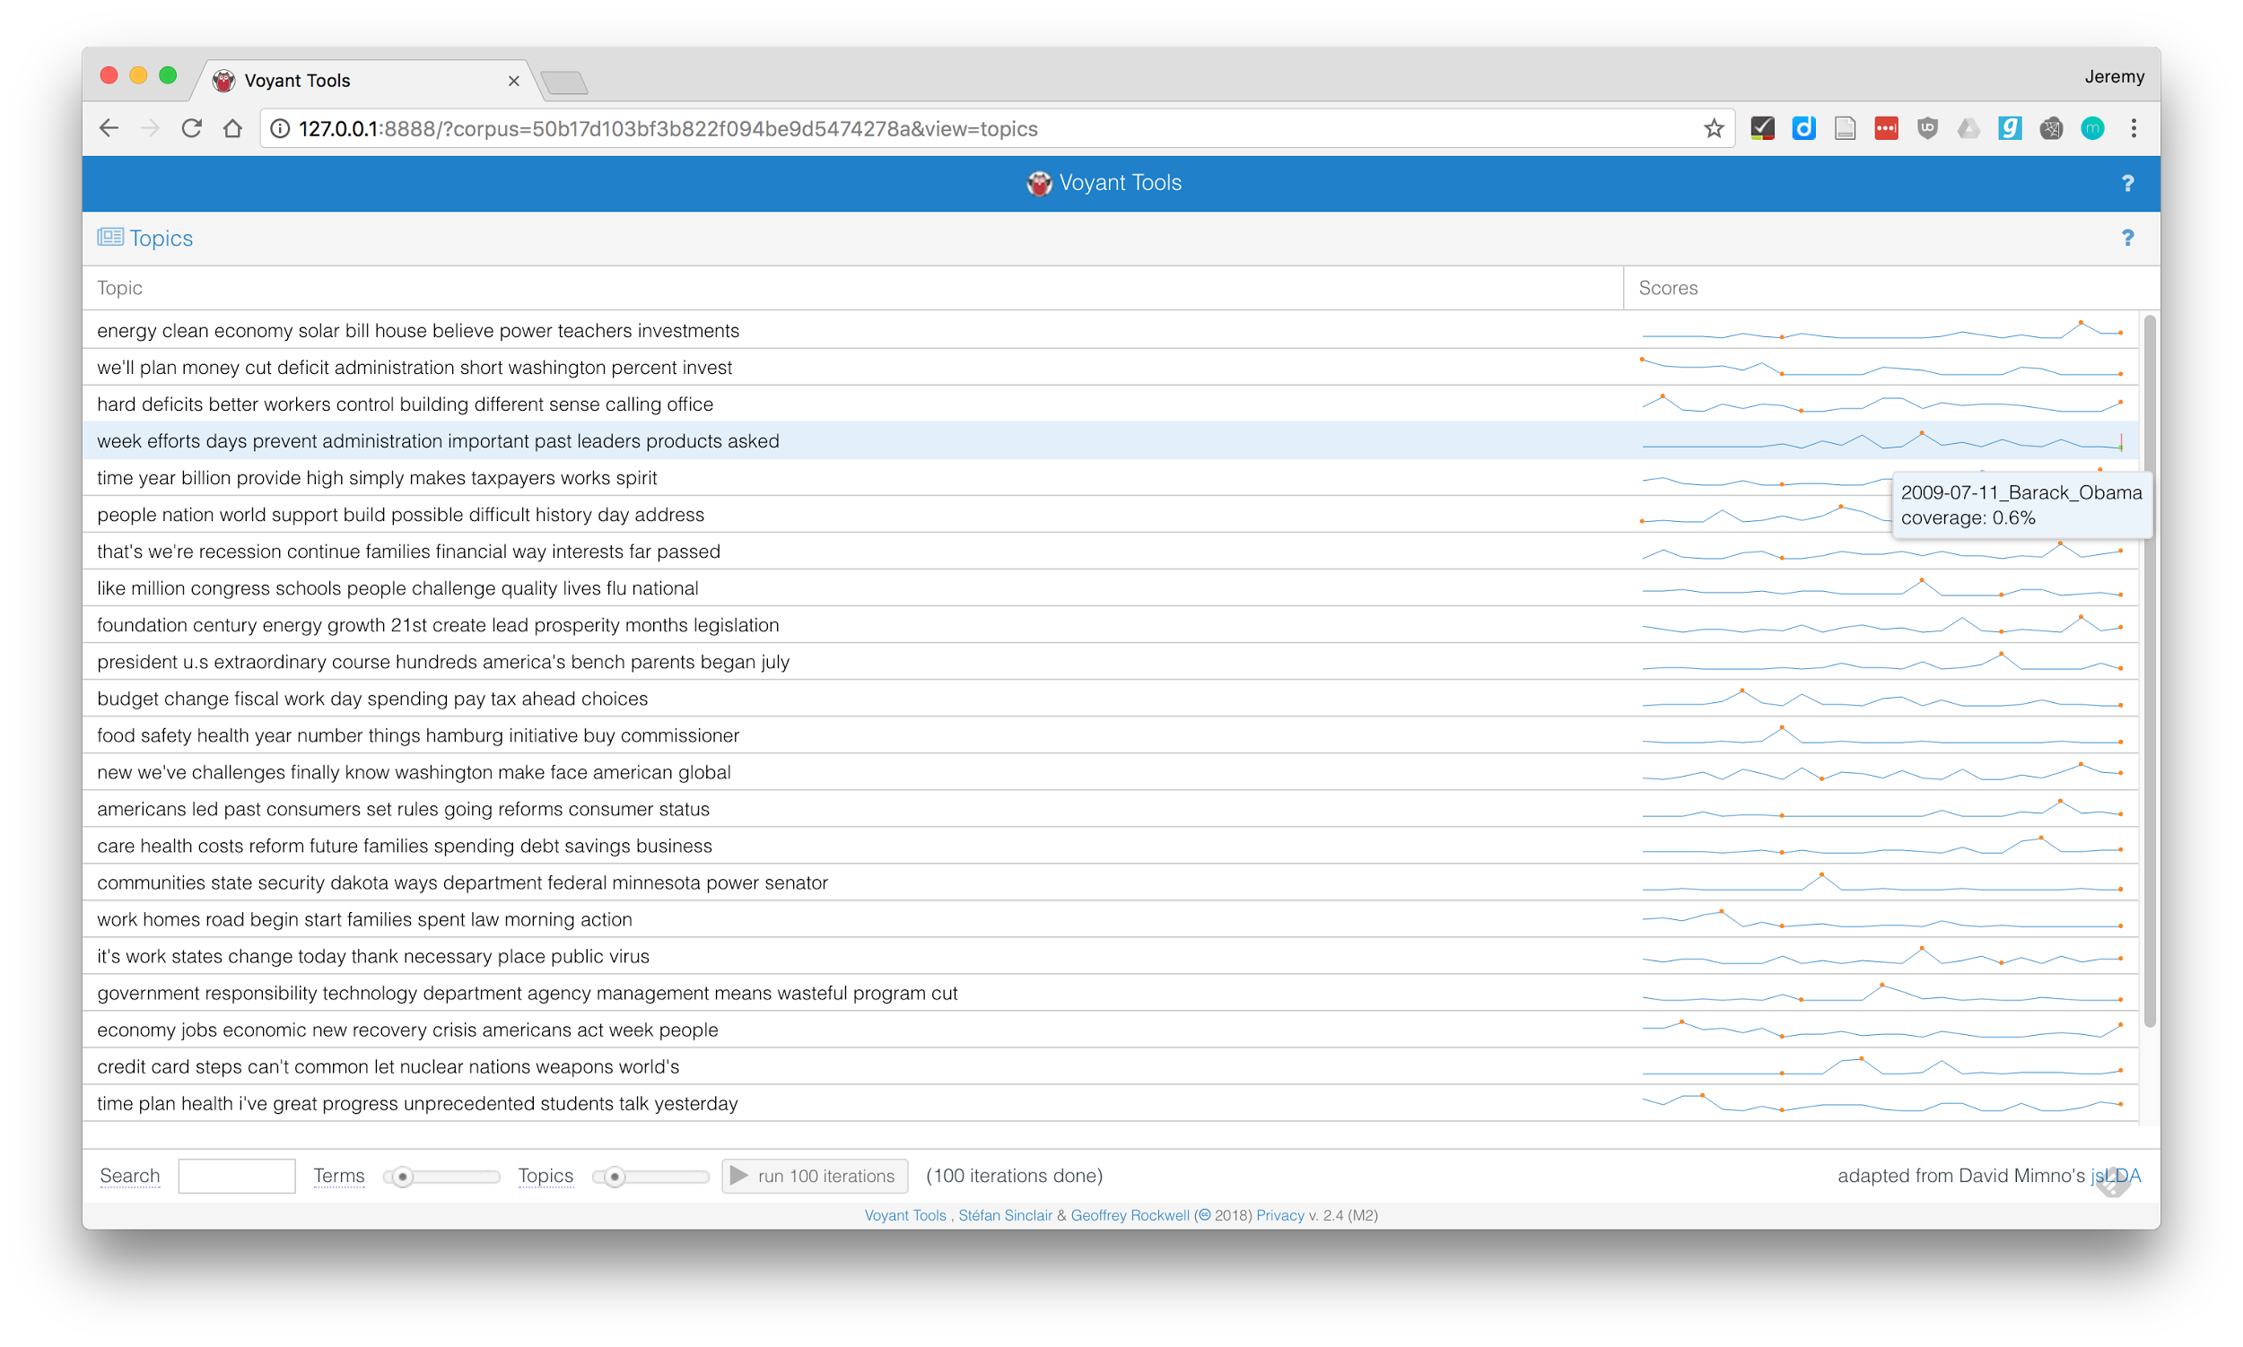
Notes:
Look at another tool in text analysis, topic modeling
The basic idea of topic modeling is to identify groups of words that appear together more often than you'd expect if you had a randomized bag of words. These groups of words that occur together often are stand-ins for the idea of a topic. Voyant has a topic modeling view, shown here, but it's one that doesn't scale very well. The sparklines visualization shows that we only have up to July for topic scores, although the options you're given don't indicate that it should. Voyant has a decent illustration of what topic modeling should be, but the implementation is buggy.

Slide 28

Text analysis tool
Runs from command line
Gives raw data output
Very scalable
mallet.cs.umass.edu
Notes:
Now we're going to talk about Mallet, which is a more robust text analysis tool, especially for topic modelling, which is something that Voyant doesn't really do

Slide 29
> /Users/Jeremy/mallet/bin/mallet --input /Users/Jeremy/Documents/obama --output /Users/Jeremy/Documents/obama.mallet --remove-stopwords
→ /Users/Jeremy/mallet/bin/mallet
Input:
/Users/Jeremy/Documents/obama
Output:
/Users/Jeremy/Documents/obama.mallet
Remove Stopwords:
True
False
Notes:
Some of you may not be familiar or comfortable with command line or terminal applications, so here's an analogy to ease you into it. Imagine an application you access online. It has different options that you set up through a form, and then you run it, and it does stuff for you. A command line application usually works in much the same way, it just doesn't show you the form. You're still setting options, but you're doing it in a different way. Both sides say the same thing, but the terminal version does it more concisely.
Since you don't have to look at every option at once, commands can be concise while still providing dozens and dozens of options without cluttering what you interact with. To find out what options are available, you have to look at documentation, or sometimes help documentation, which you can usually get at with the --help flag

Slide 30
_import.config
input = txt
output = obama_first_year.mallet
remove-stopwords = true
keep-sequence = true
> mallet import-dir --config _import.config
Notes:
Mallet has some options to make things even easier for us. The documentation will point you towards command line options, but you can replace those with a single config file that you can modify and reuse. I recommend this because it's easy to forget what options you specified in the terminal 6 months ago, but if you have the config file, you know exactly what you did.
To do topic modeling with mallet, first we have to make a special file for it to use for its topic modeling, that it creates from our corpus, or folder of documents. We tell it where the corpus is, where we want the output, that we want to remove common words from the model (like "and" and "the"), and that we care about the sequence of the words and want to preserve them in our analysis

Slide 31
_train-topics.config
input = obama_first_year.mallet
num-topics = 10
output-state = topic_state.tar.gz
output-doc-topics = topic_scores.tsv
output-topic-keys = topic_keys.txt
> mallet train-topics --config _train-topics.config
Notes:
With the mallet-ready corpus prepared, we can do the actual topic modeling. We have to give it some more options in this case:
The corpus
The number of topics
A reusable output state
Where we want the topic scores for each document
Where we want the keys for each topic

Slide 32
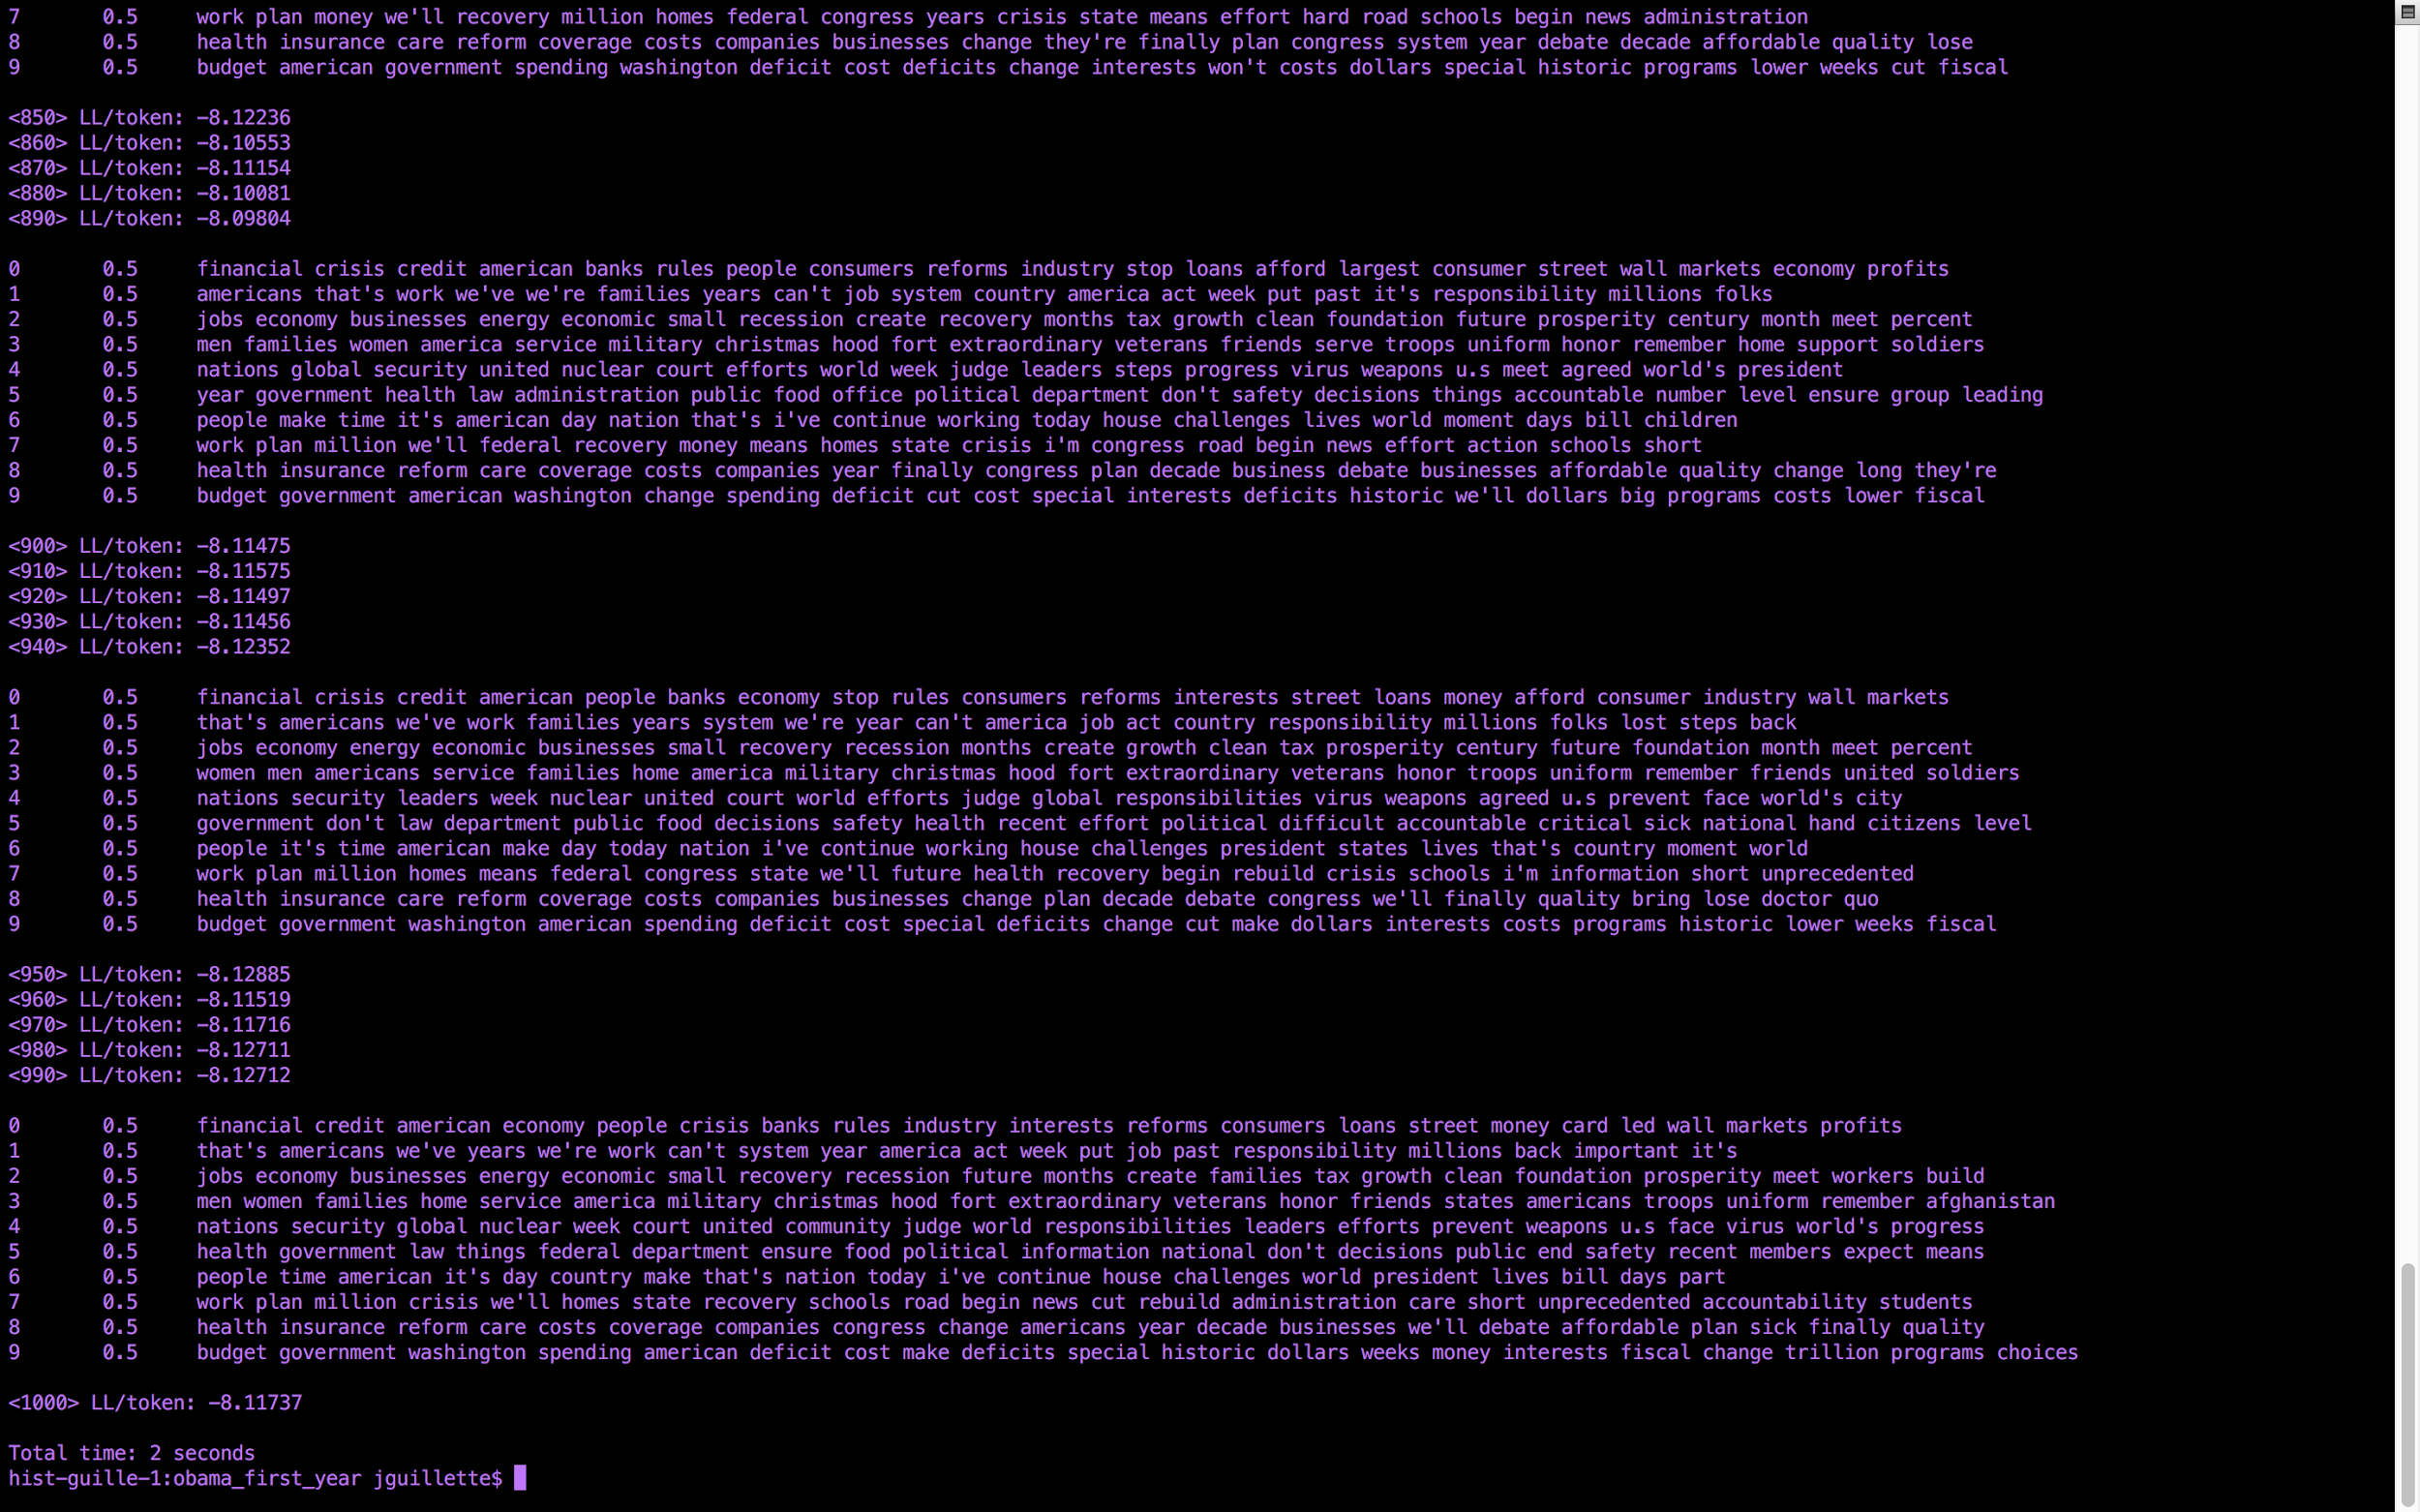
Notes:
When you run the command, you'll see something like this. Topic modelling is an iterative process, and Mallet shows you what the topics look like as they're being formed. There's an element of randomness, so you might not see the same words in the same order, but you'll probably see very similar groupings of words overall

Slide 33
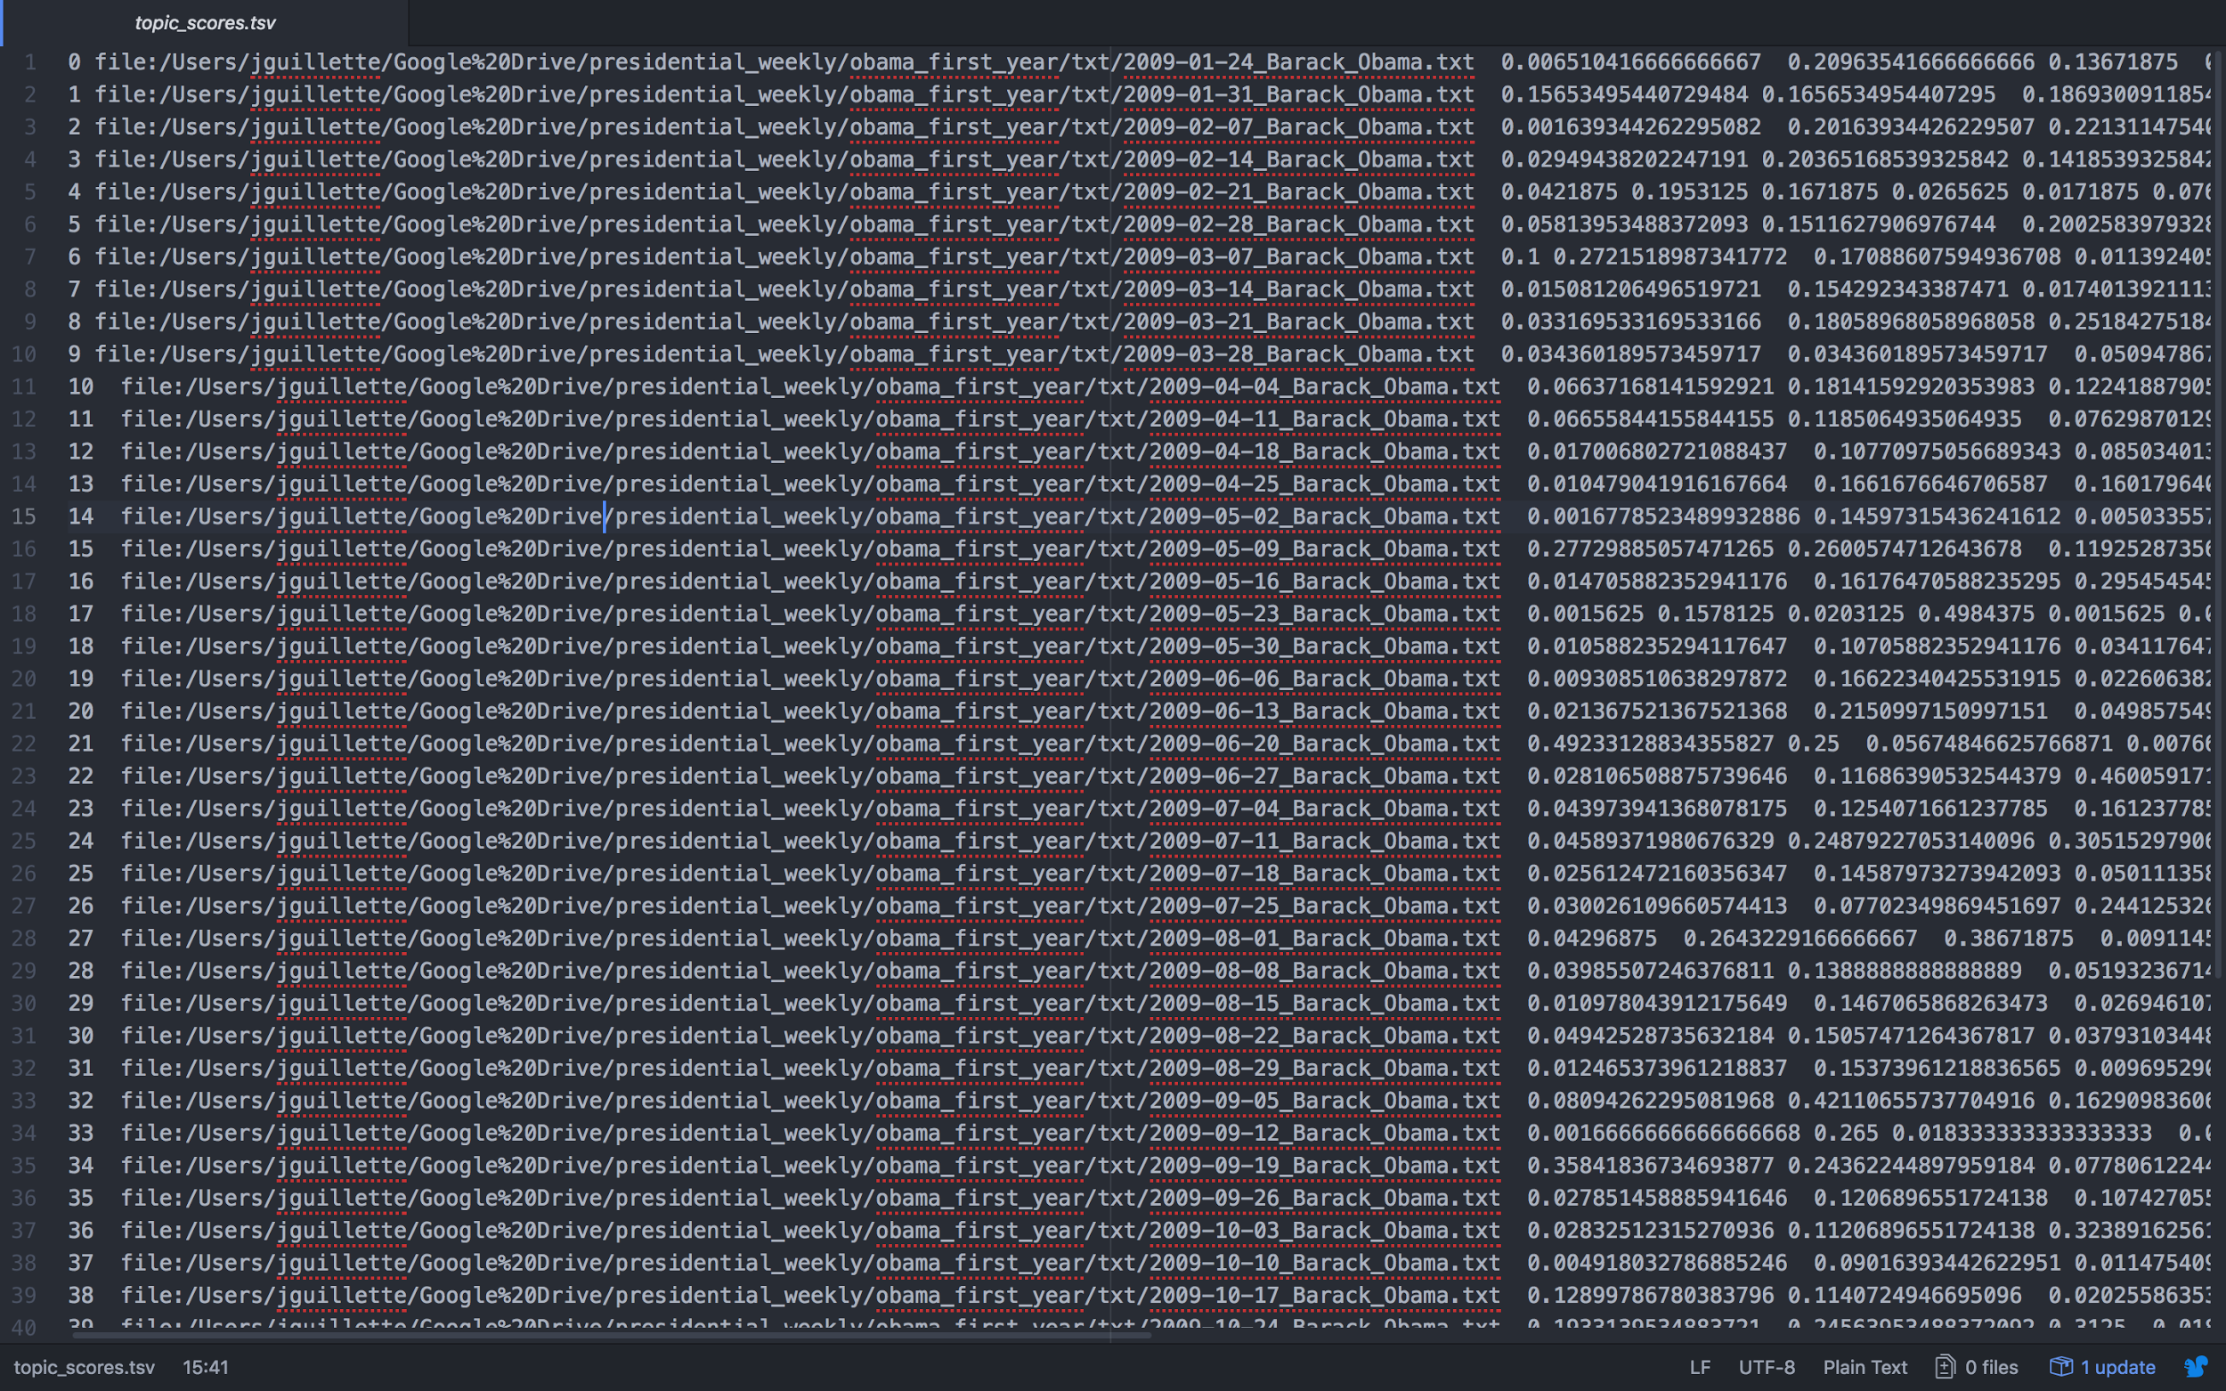
Notes:
This is the raw text output of the analysis. Looks kinda hairy, but if you copy and paste it into a spreadsheet...

Slide 34
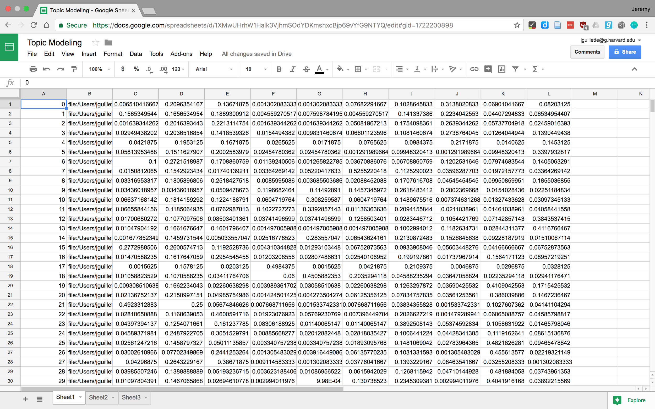
Notes:
It looks a bit better. Still pretty impenetrable though. Maybe some headers would help?

Slide 35
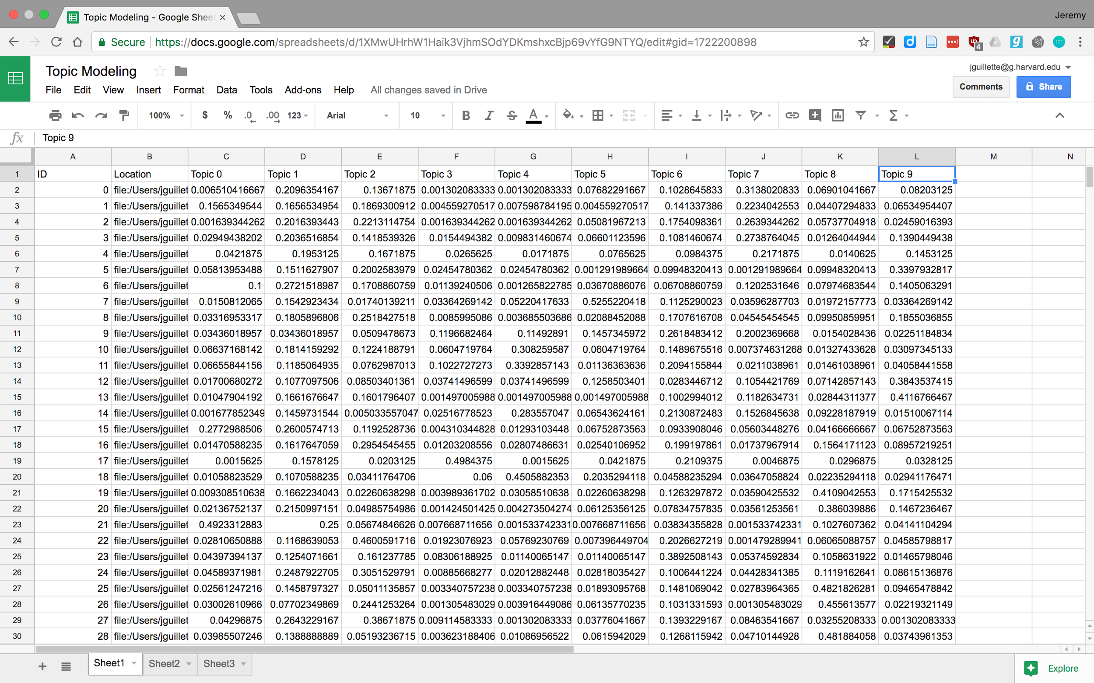
Notes:
Getting better. I'm counting from 0 on the topics because Mallet does too, and it'll make things easier in a bit. Let's get the important part out of the filename, the date.

Slide 36
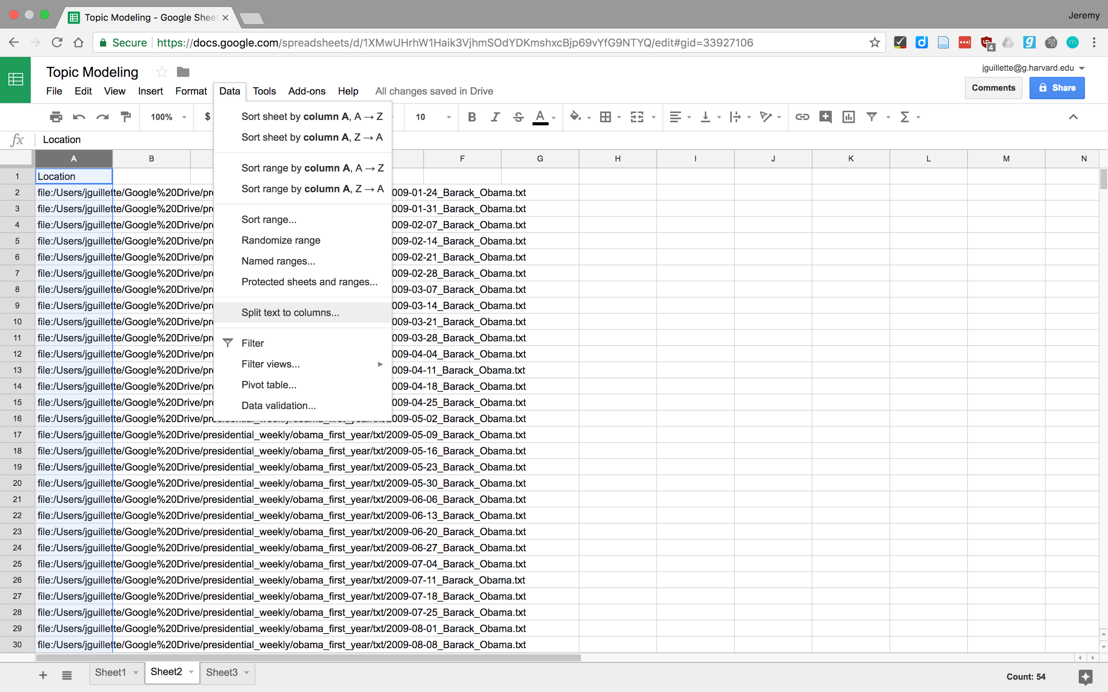
Notes:
Copy the data into a new sheet and split the text to columns...

Slide 37
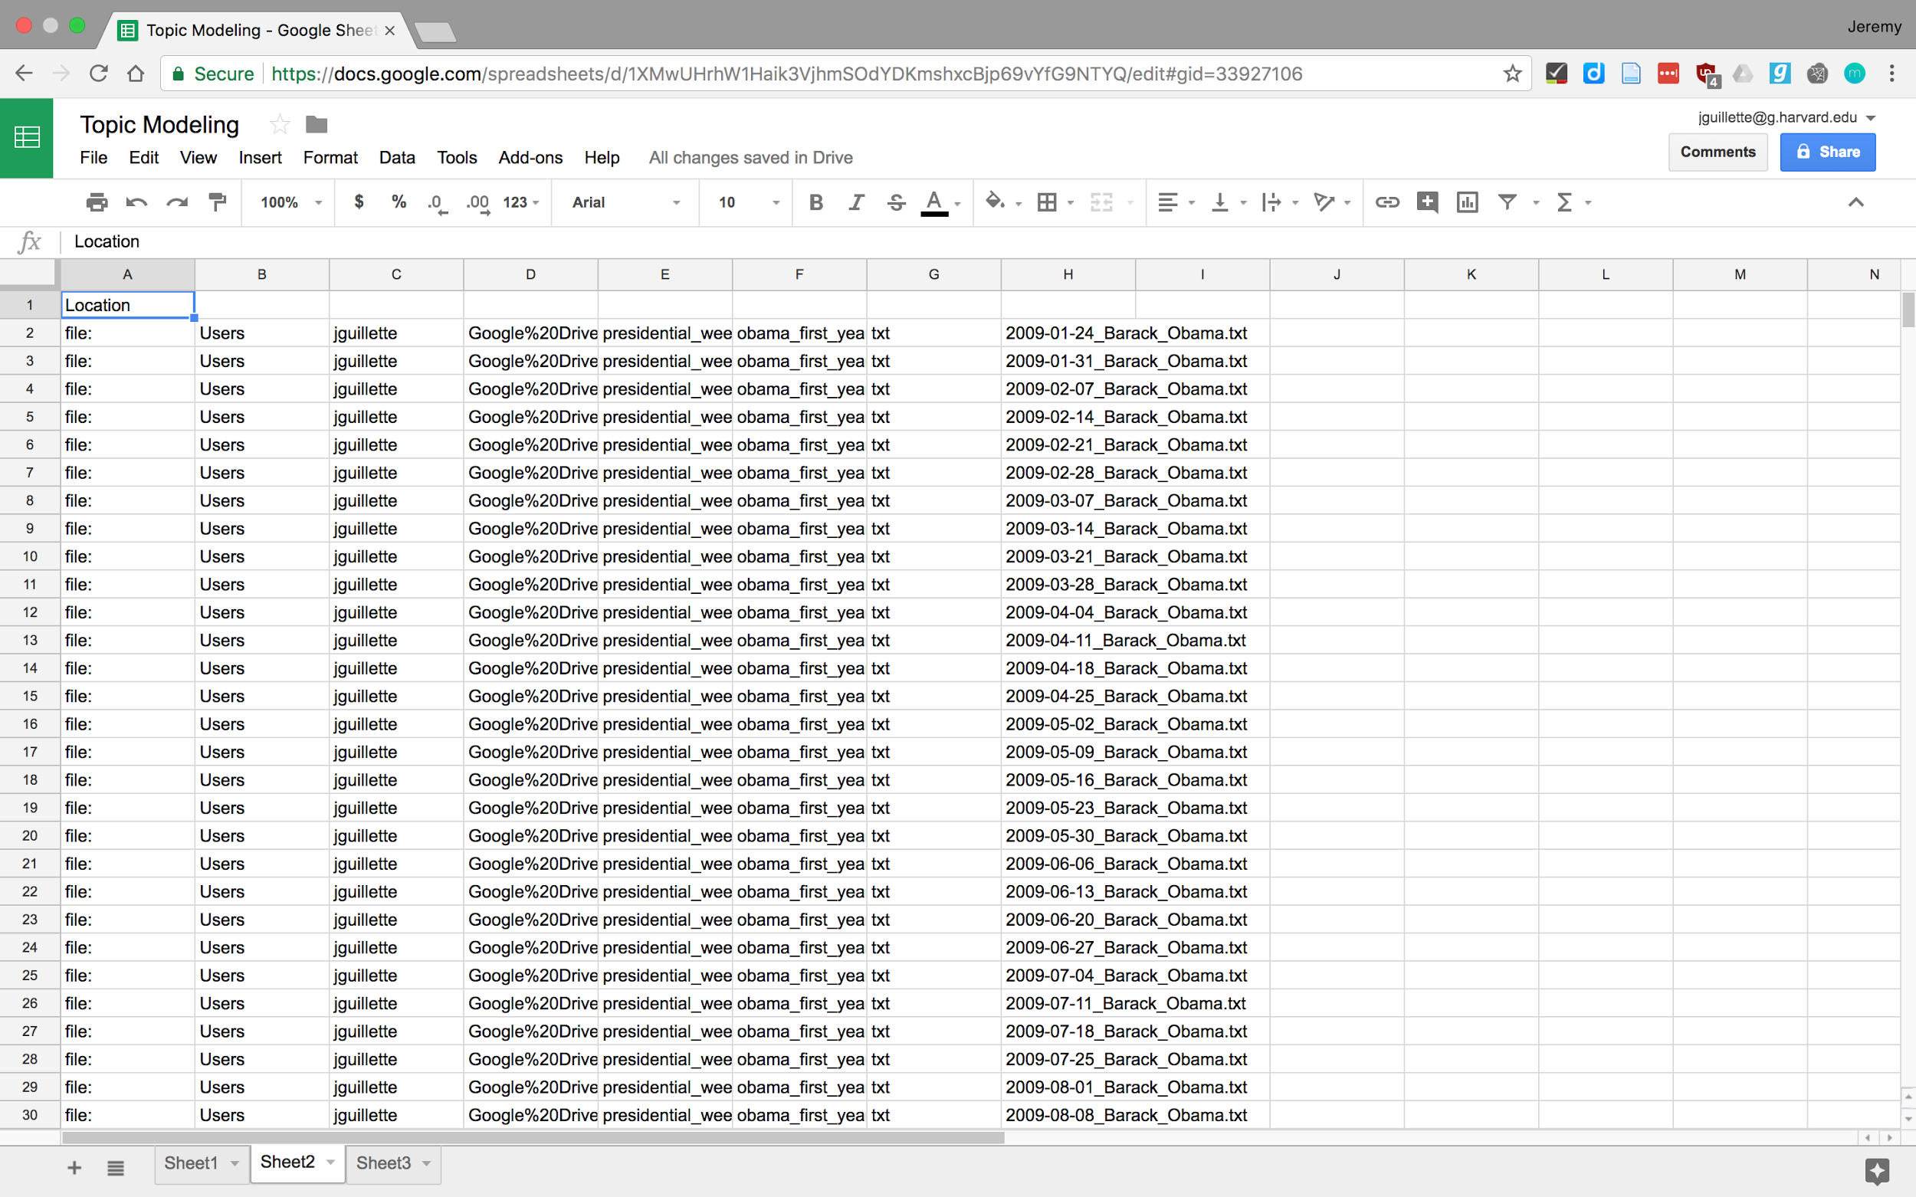
Notes:
Using the custom separator "/" we get this...

Slide 38
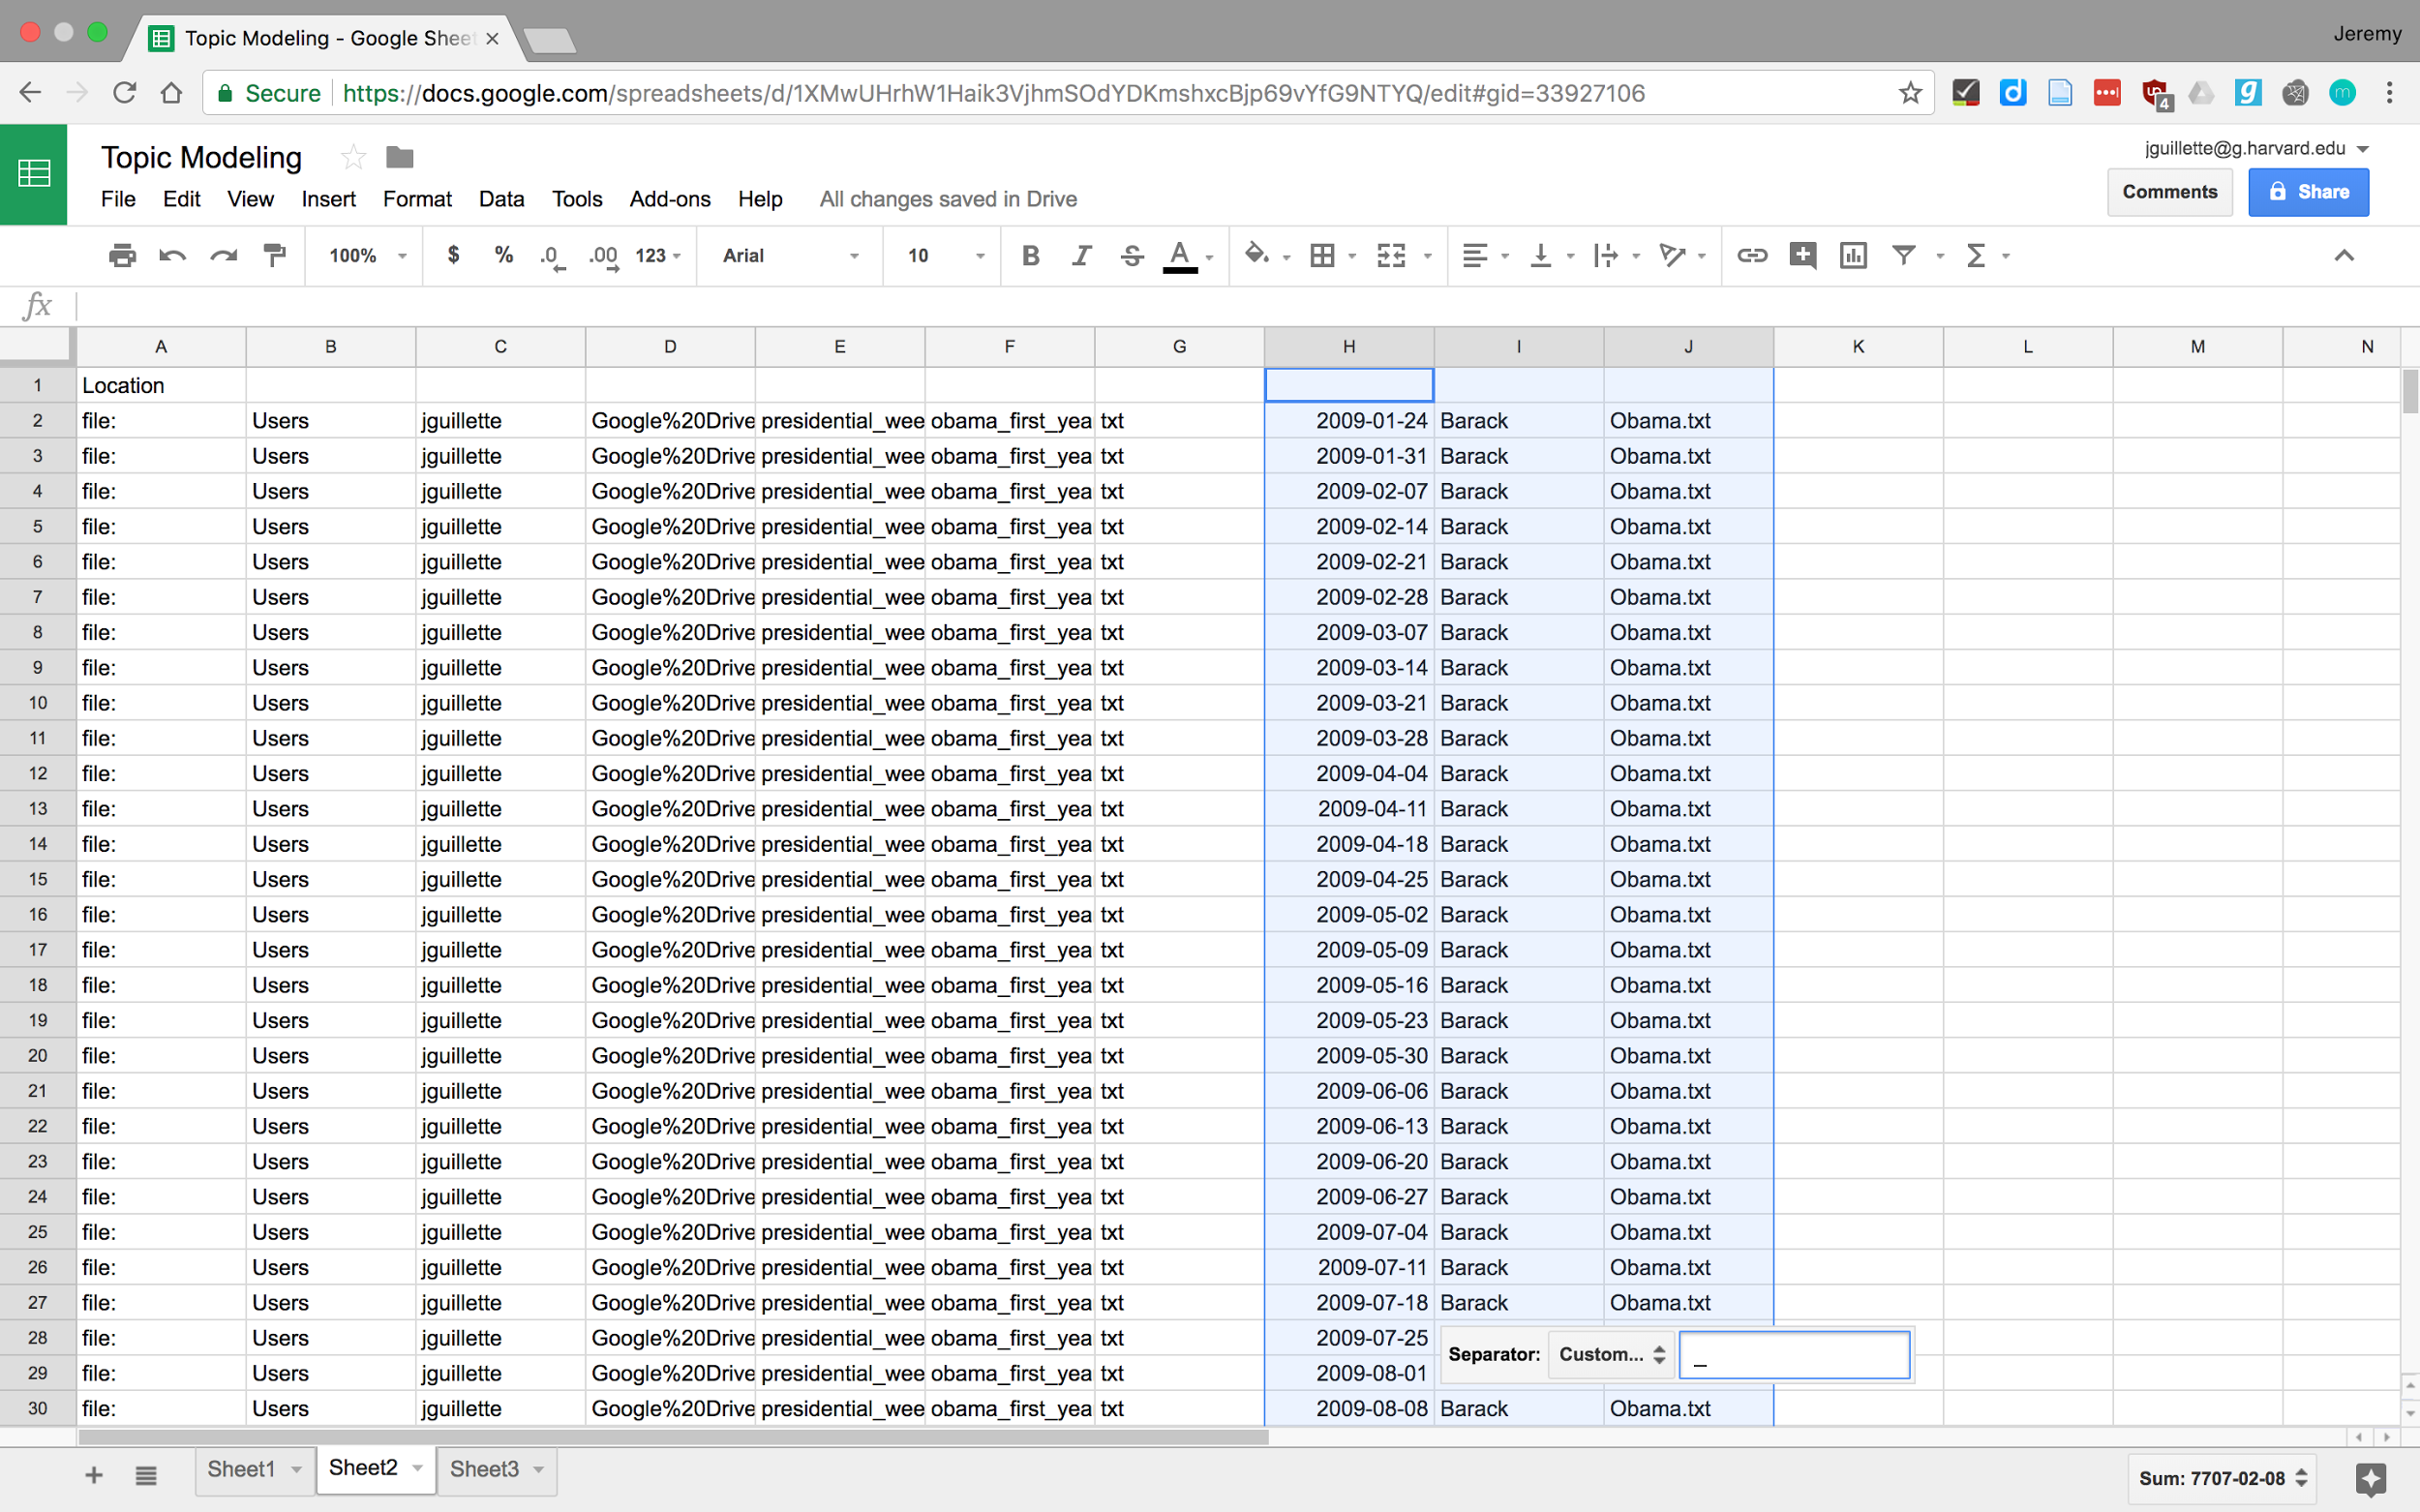
Notes:
And splitting the filename on the underscore gets us some isolated dates like we want, so I can copy that column back into our data.

Slide 39
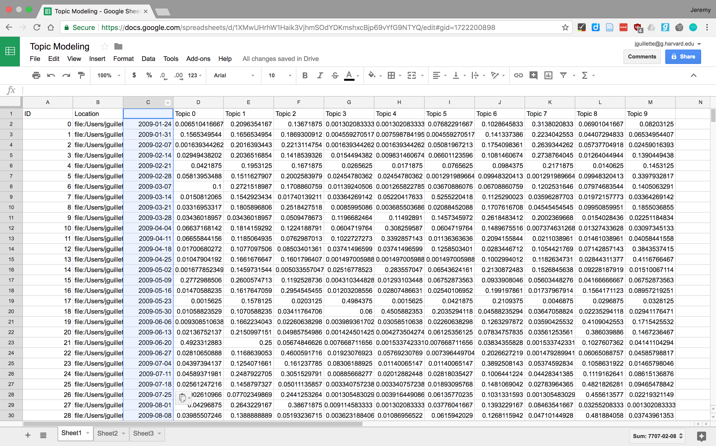
Notes:
And here it is, our dates in place. Now we can start interpreting what's going on here. First, we'll need our topic keys, so we know what these topics are

Slide 40
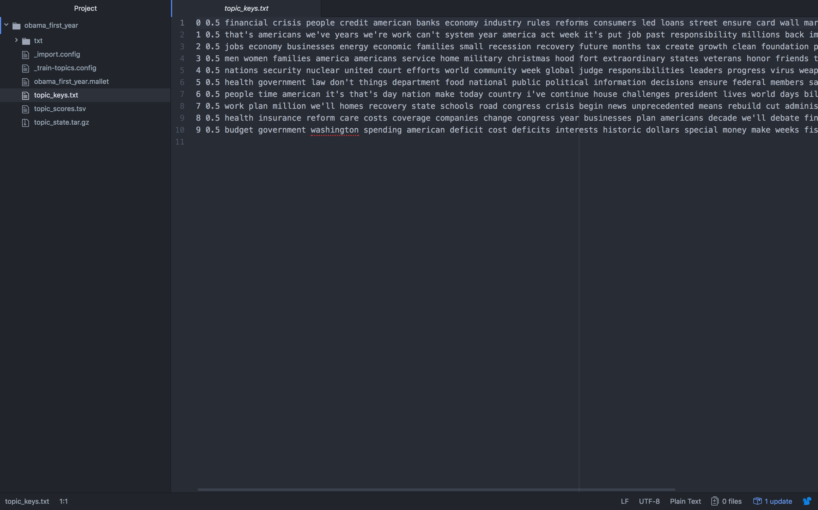
Notes:
The topic keys look a bit like what we had before, so let's copy that into a new sheet in our spreadsheet

Slide 41
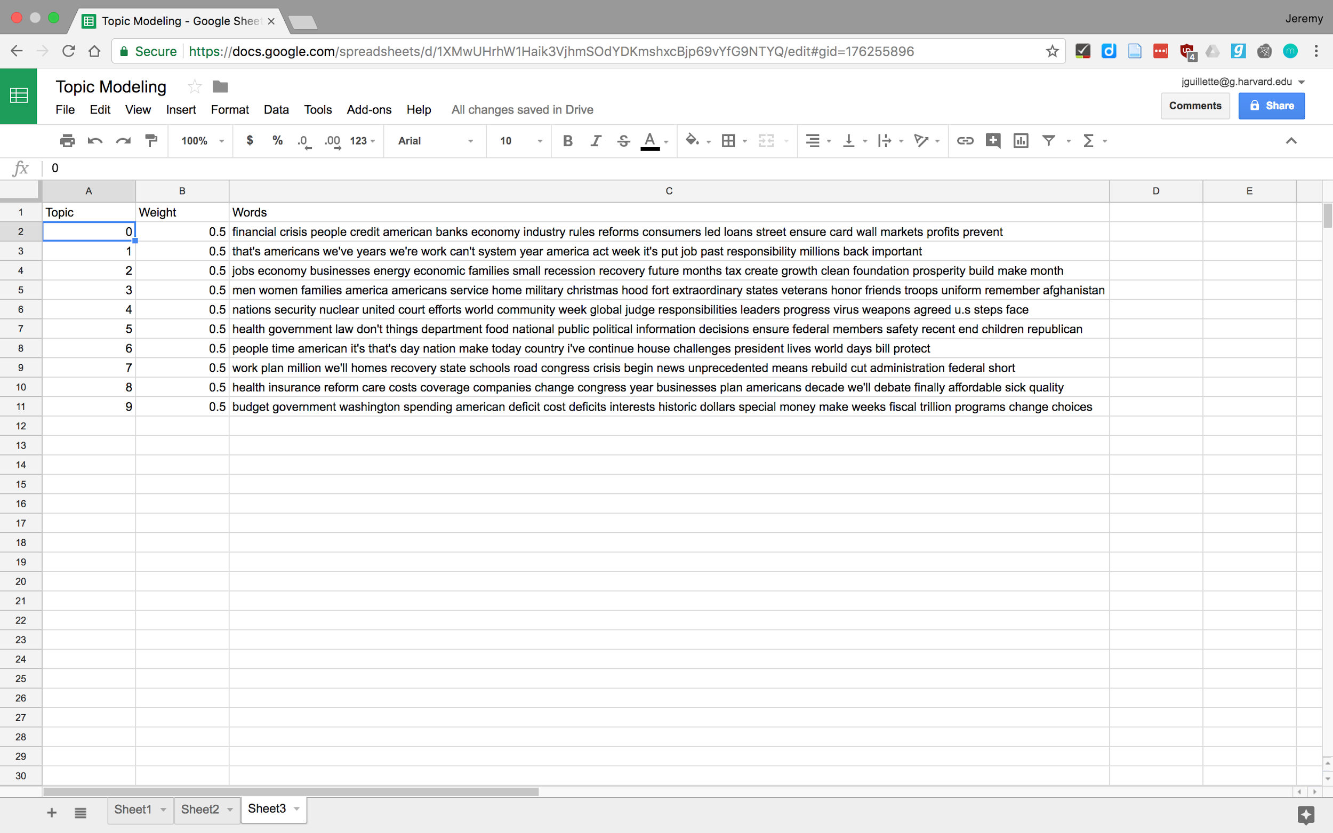
Notes:
I've added some column headers, and we're just going to worry about Topic and Words. Weight is something you can mess with if you're getting further into the math behind topic modeling, which we will not. We've just used the defaults that Mallet gave us, which are good enough.
This is where you start interpreting topic modeling. You'll want to give short names to the topics for ease of use.

Slide 42
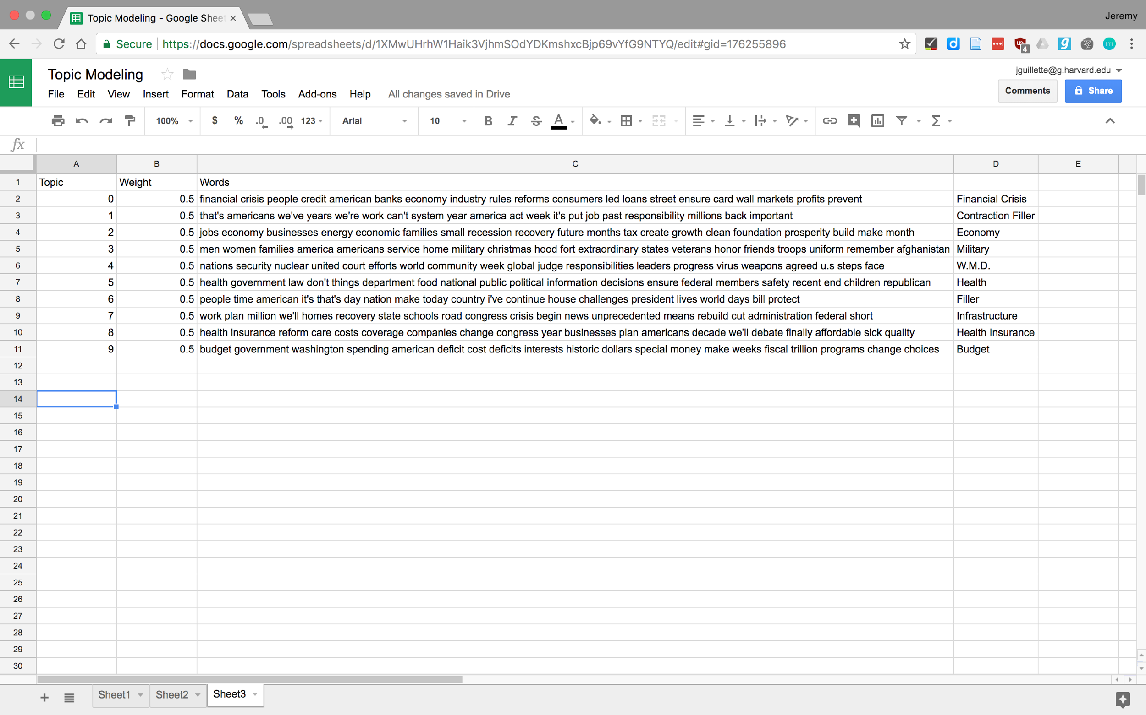
Notes:
I've assigned labels that make some sense to me, although I might change the "Filler" topics eventually. Let's make some graphs of our own!

Slide 43
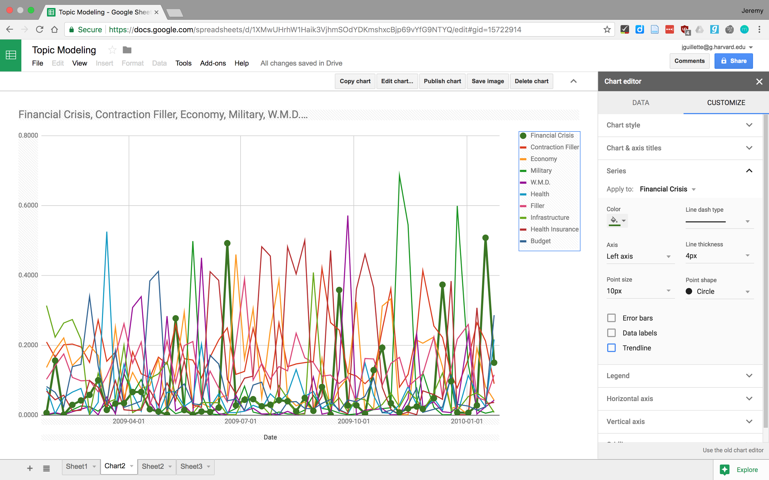

Slide 44
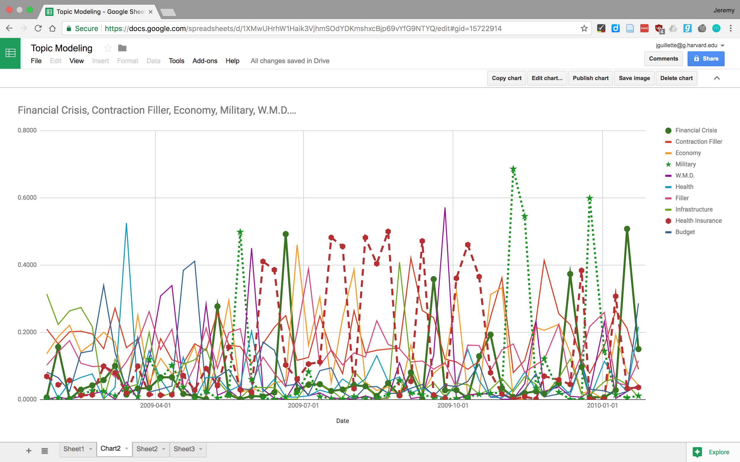
Notes:
If I do some kind of unappealing things to the chart, you can see some other things, like insurance trends, and that the president talks about the military around military holidays like Veteran's Day in November. Like we did with term frequencies that we noticed, we can compare these to other events to see what was happening. Also, the fact that all of these ideas seem intuitive make a good case for this being useful for larger datasets, or ones that we know less about to begin with, so that we can get a sense of them at scale even if we don't read every one.
Pairing the results of topic modelling with more high-powered visualization tools like tableau can be even more fun, and can let you see and interrogate trends even more quickly, while tools like D3 can help with creating robust, durable visualizations

Slide 45
What Next?
When you outgrow Voyant, try:
Python NLTK
Mallet
Stanford NLP Software
Google Natural Language API

Slide 46


